Slide 1

ALY6010 Final project
Spotify Dataset Analysis
Prepared By : Shyamala V
Date : 12/9/2022

Slide 2
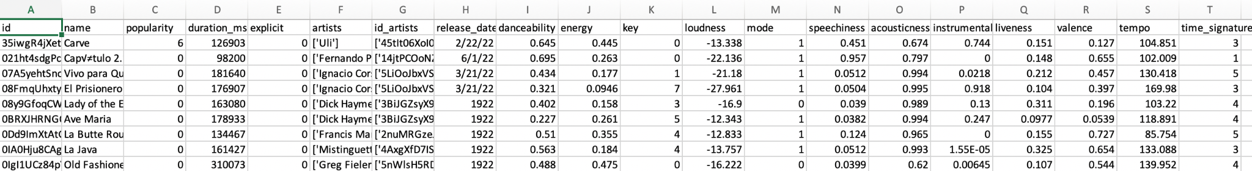
Understanding the dataset
This dataset provides audio information for around 586672 audio tracks and has 20 columns, each of which describes the track and its characteristics.
There are 5 categorical variables and 15 numerical variables.
Data Definition:
The Spotify developer platform - web api can be referred for the meaning of these columns in the dataset.
Name - This column refers to the name of the song/audio track
Artists - This column refers to the name of the artists involved in the song.

Slide 3
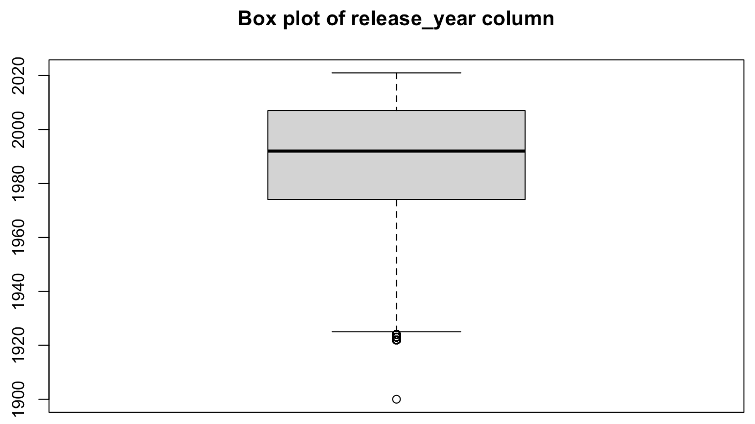
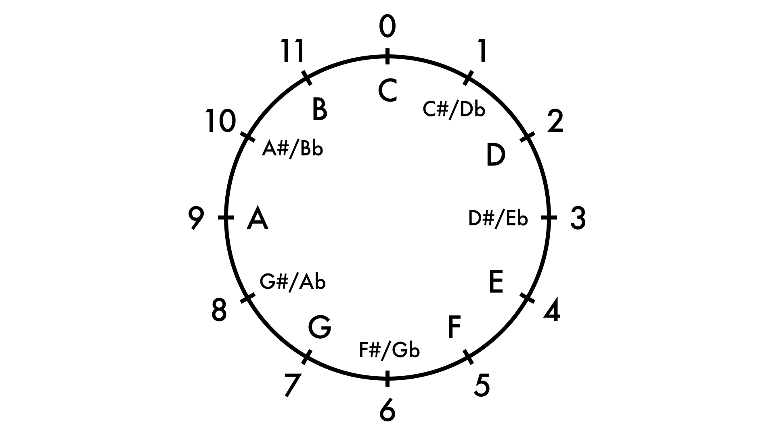
Data cleaning
Corrected the release_date column - moved the year value to a new column release_year, and date to release_date.
Removed the brackets and quotes from the artists column to make it more readable.
Converted the duration of the song in milliseconds (duration_ms) to duration in minutes and renamed the column (duration_min).
Removed the records with release year before 1930.
Removed the outliers from the dataset using IQR criterion and the resultant dataset has around 450336 records.
Added a column Decade to denote the decade in which the song was released.
Added a column key_class to hold the mapping of song keys to its key class based on the pitch-class notation.
Mapping of song keys and its pitch class

Slide 4
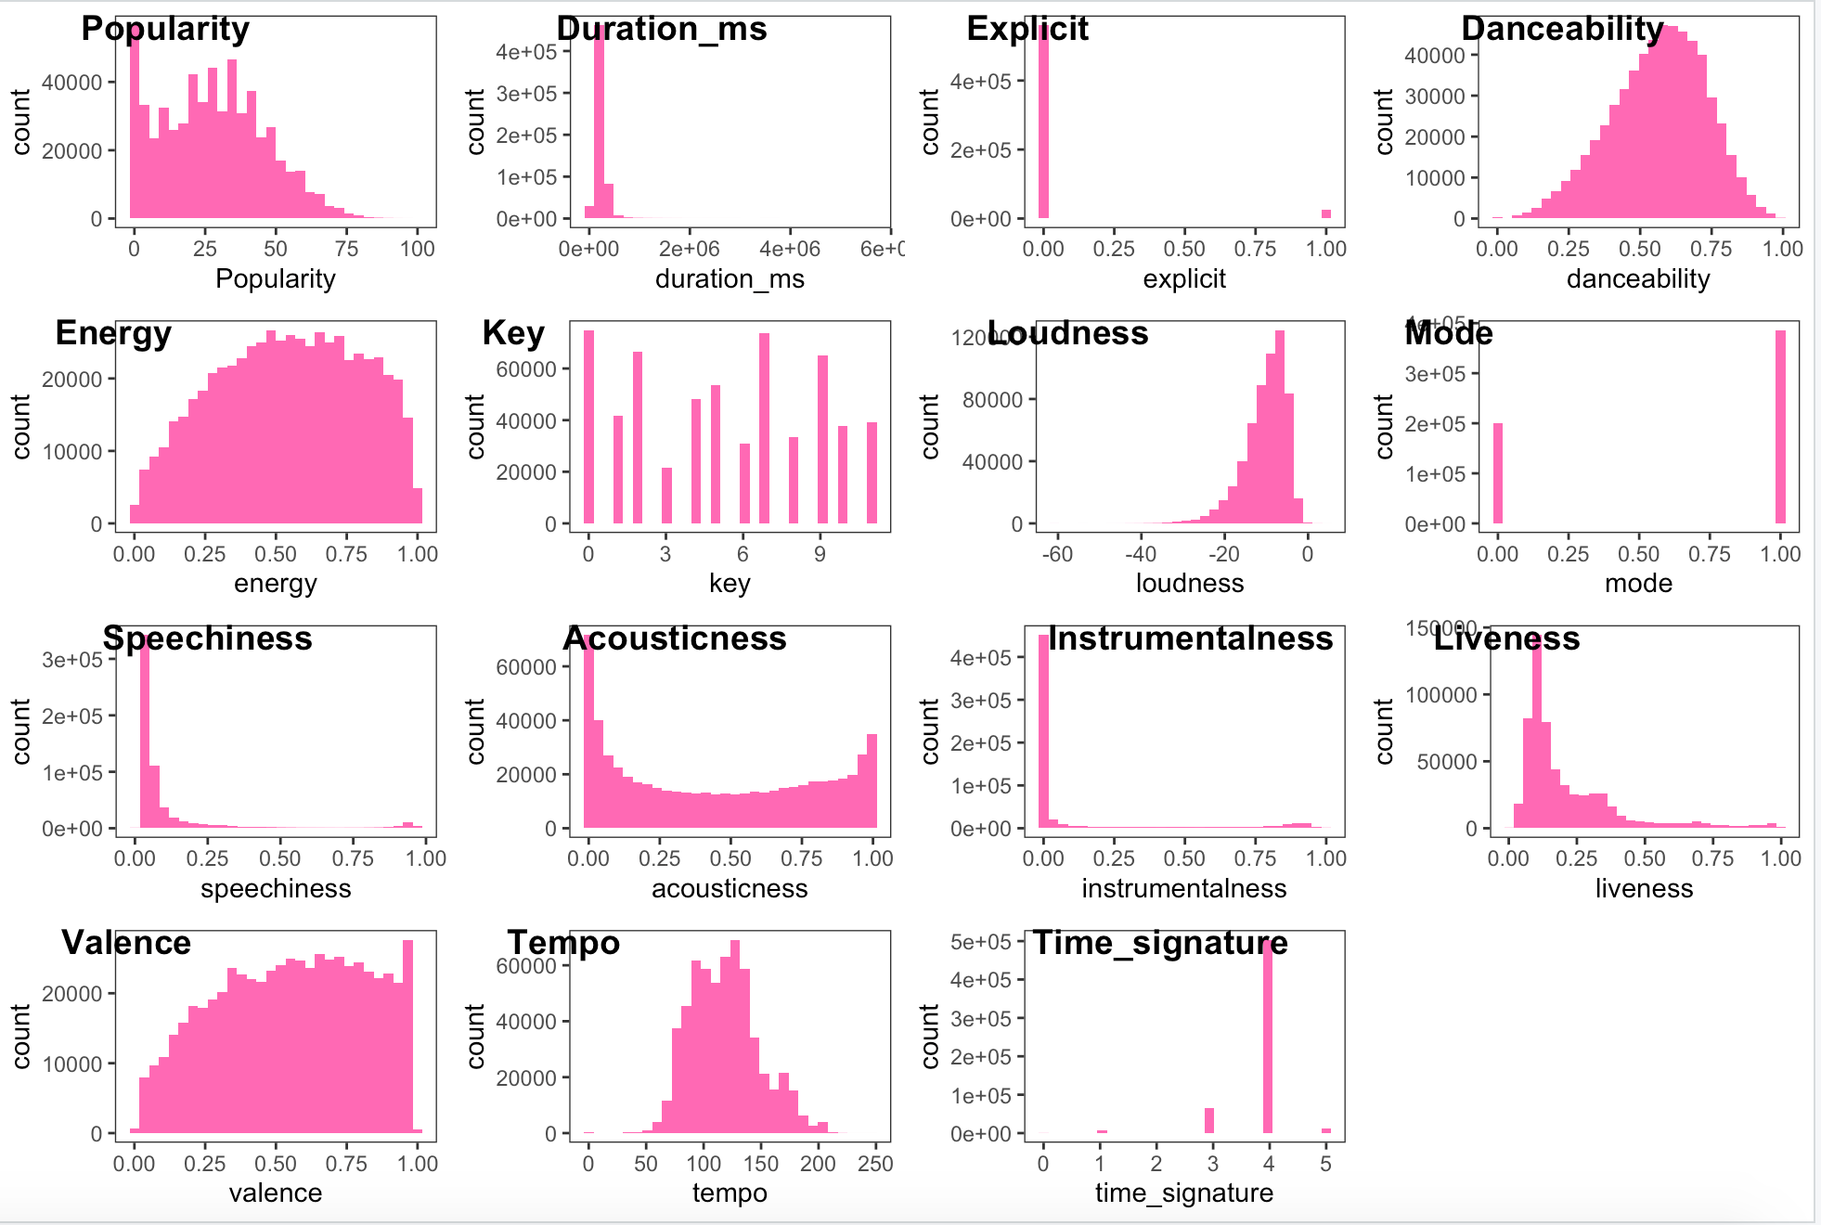
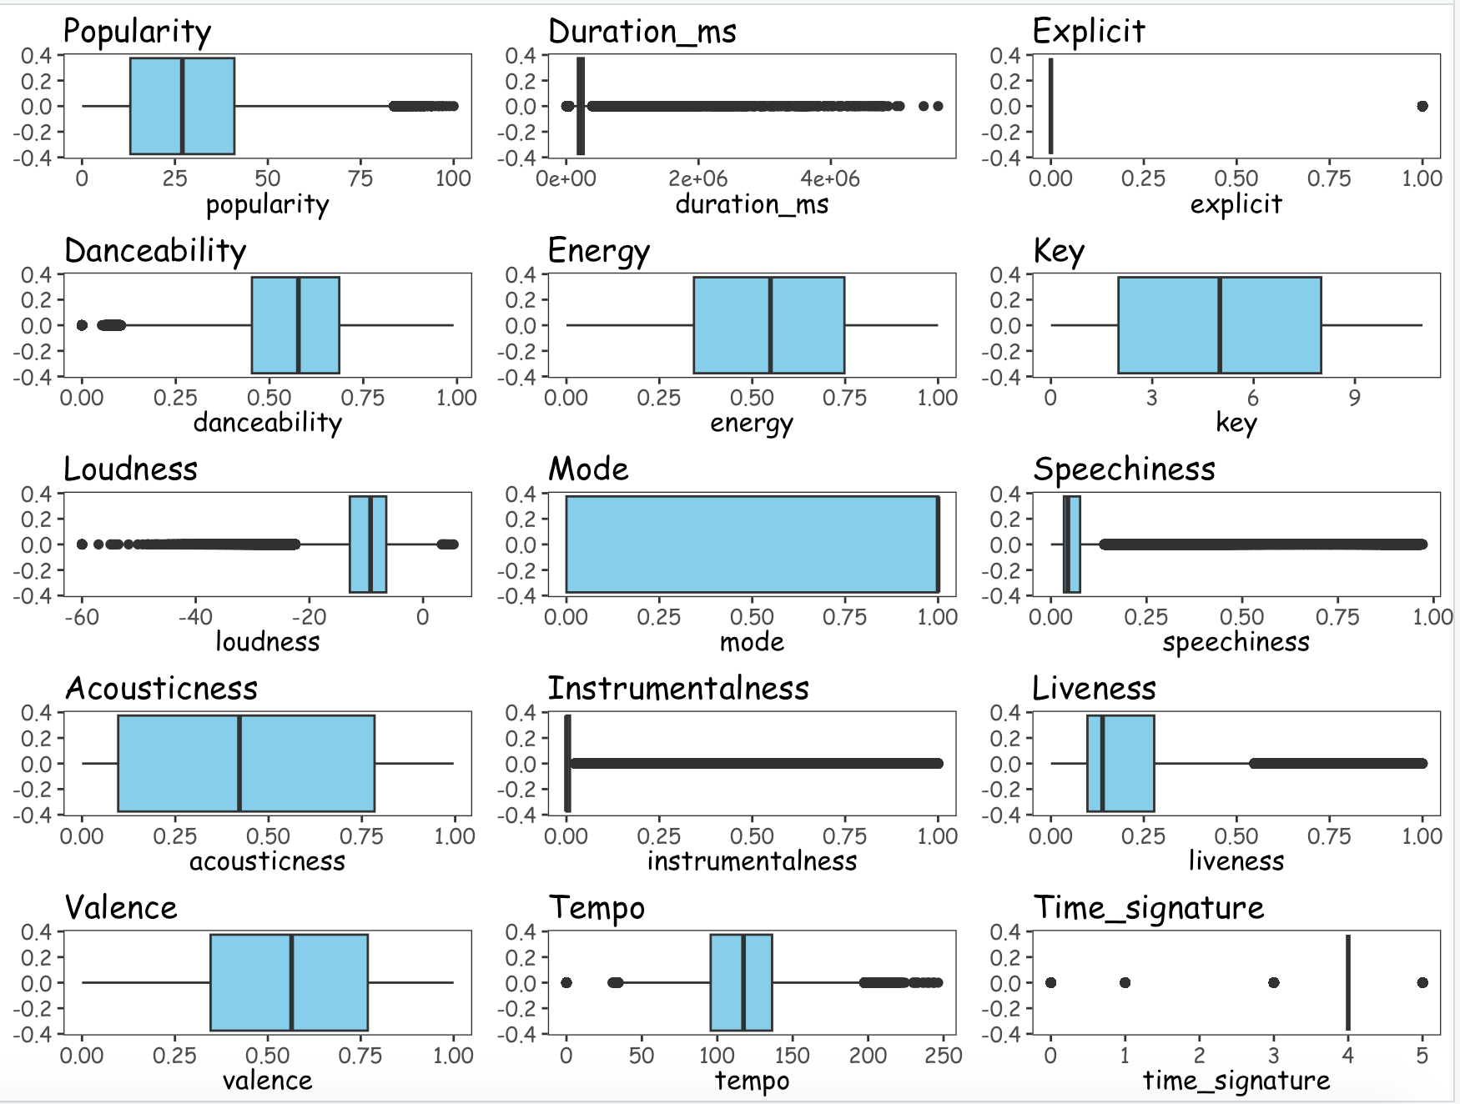
Histogram and Boxplot of the song features:

Slide 5
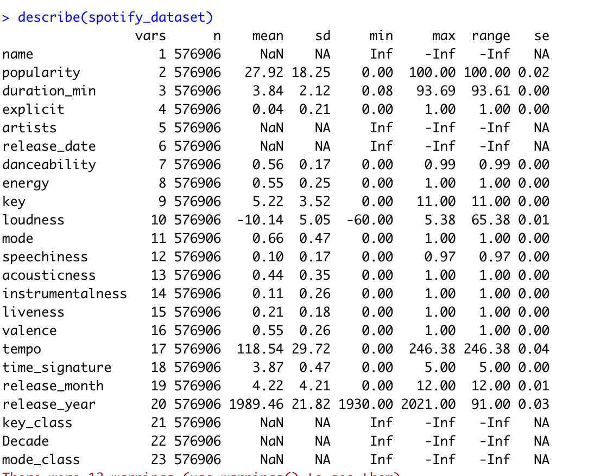
Descriptive statistics summary table
Most of the songs are having a popularity score of less than 50. Hence majority of the songs are not very popular.
The average duration of the songs is around 3.5 to 4 mins.
A very few songs have explicit content which means that the ,most of the songs do not contain any offensive,angry,violent content and doesn't require parental guidance.
The danceability,Energy,tempo variables have a normal distribution,which means most of the songs have these values around the mean values.
The songs are available in all the key ranges. Songs with key of C,G are more in number and tone of D#/G# are the least in number.
Most of the songs are having loudness value in the range of -20 to 0.Which means majority of the songs are quite loud in nature.
We have songs played in major mode more in number than songs played in minor mode.
Most of the songs have less spoken words and feature "speechiness" describes it.
Majority of the songs were not recorded with a live audience.
Almost , all the songs have a common time signature 4/4.
Most of the songs have a mix of instruments and vocal content.

Slide 6
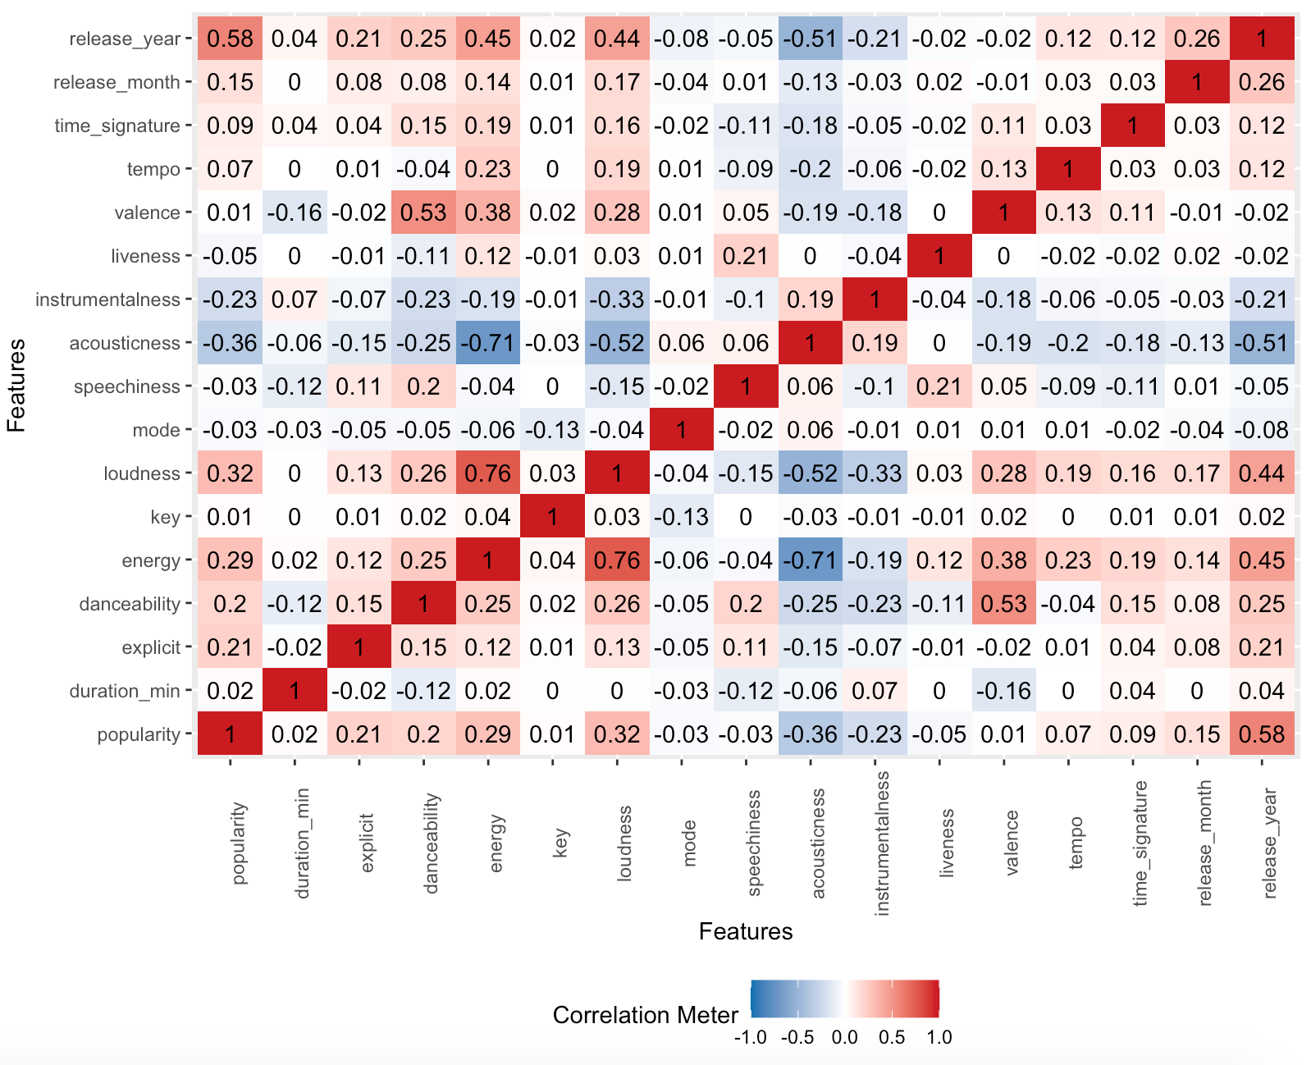
Correlation between the variables
Song popularity and valence has a positive correlation to the song attributes like energy, loudness, danceability and a negative correlation with acousticness and instrumentalness.
Energy and loudness attributes are highly correlated.

Slide 7
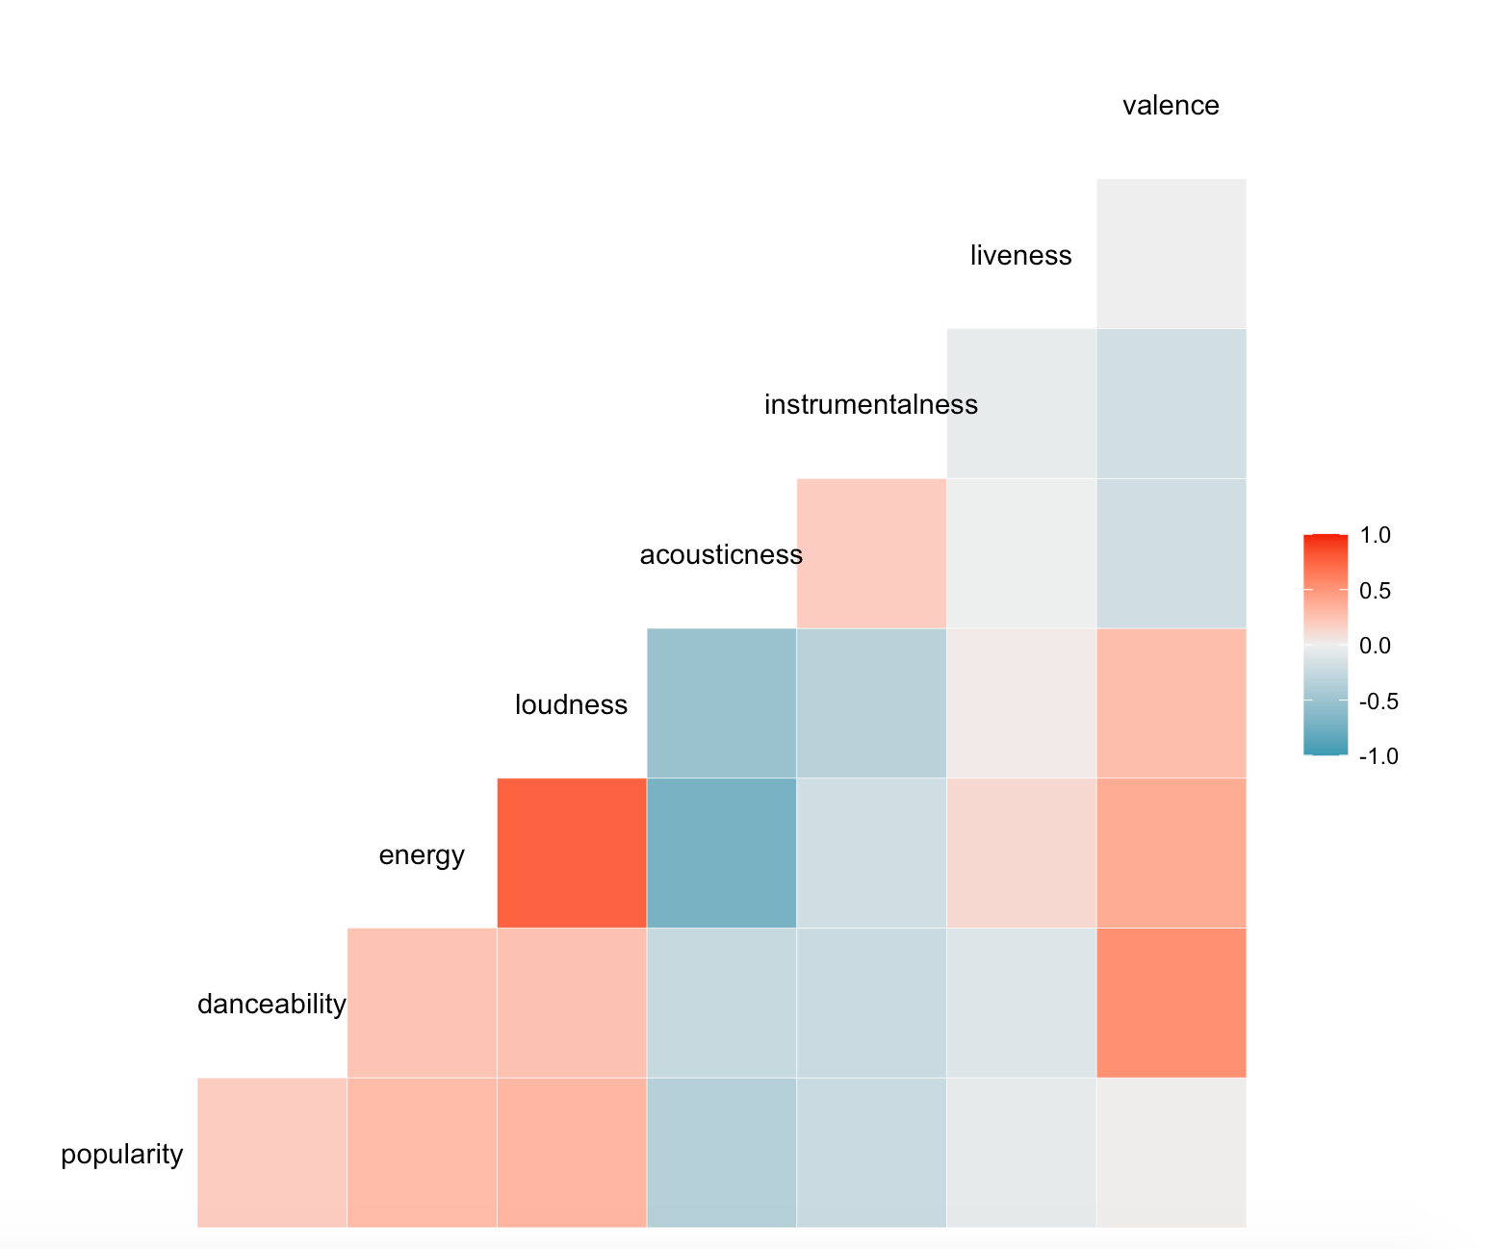
Correlation between the variables

Slide 8
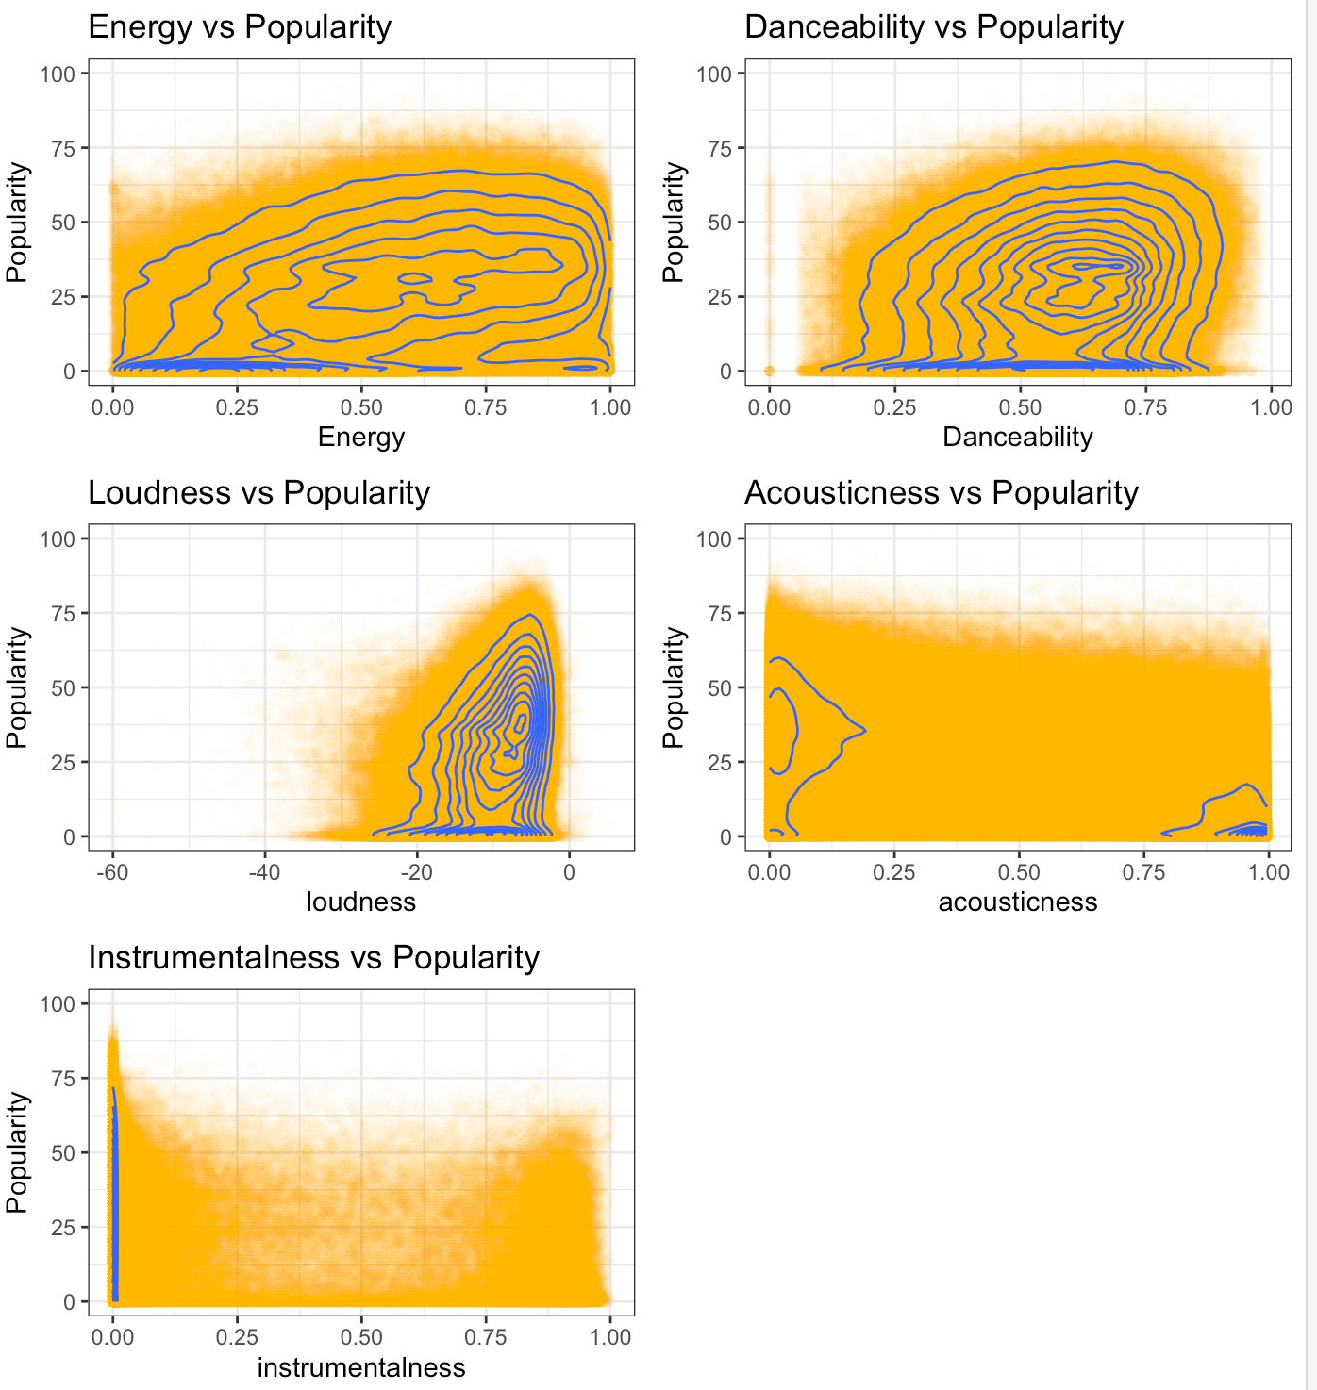
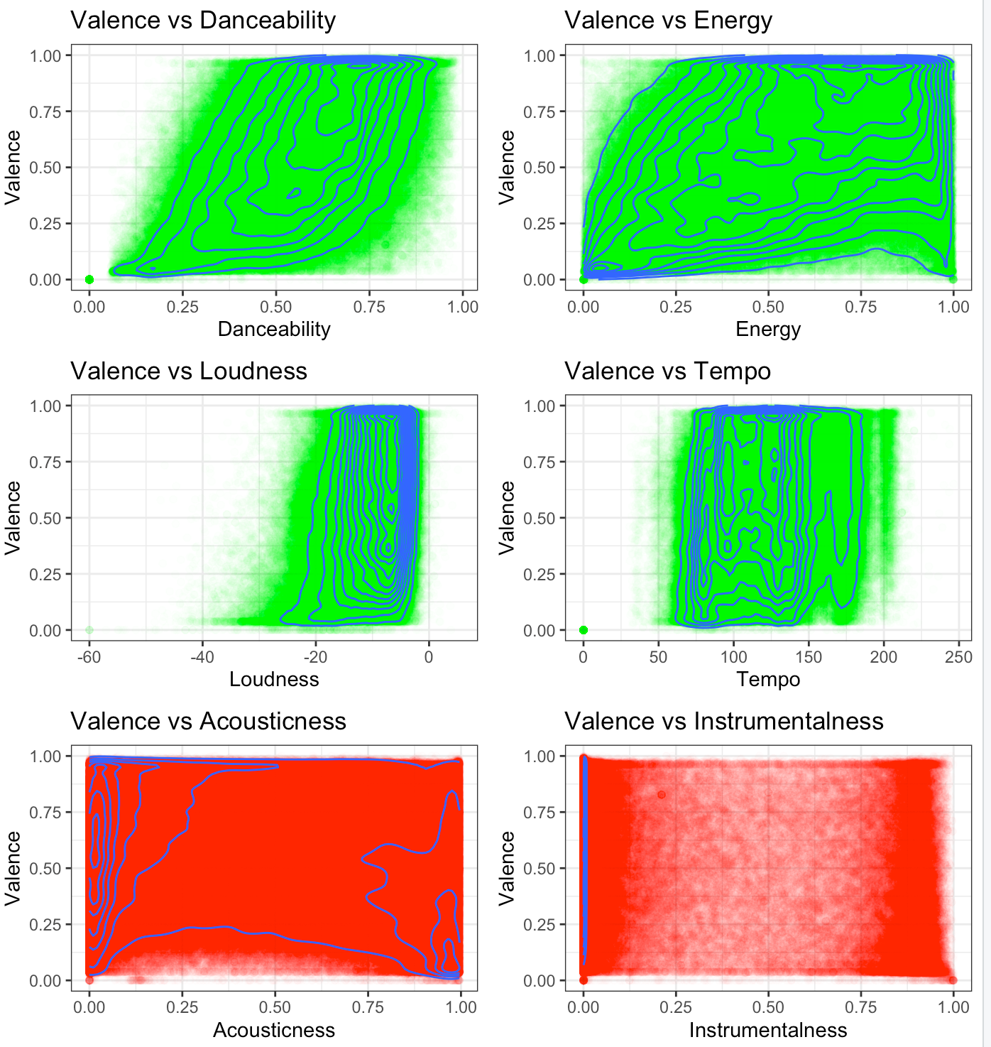
2 D density plot of popularity, valence and its related attributes
Corr : 0.29
Corr : 0.2
Corr : 0.53
Corr : 0.38
Corr : -0.36
Corr : 0.28
Corr : 0.13
Corr : 0.32
Corr : -0.23

Slide 9
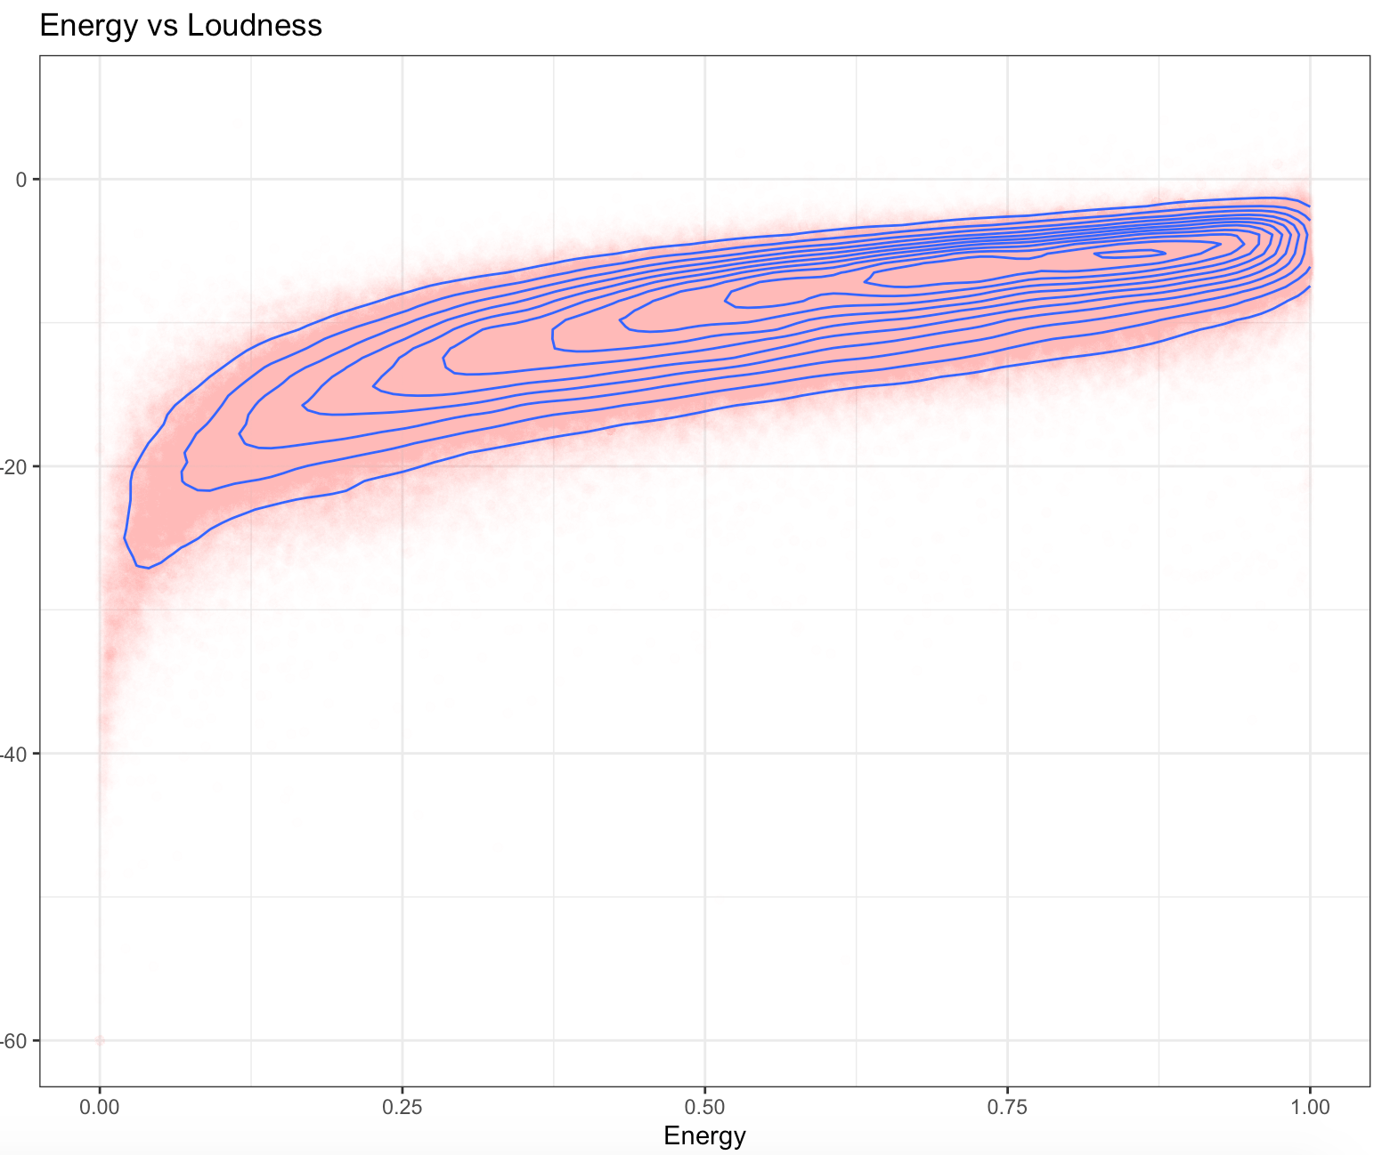
2 D density plot of Energy vs Loudness
Corr : 0.76

Slide 10
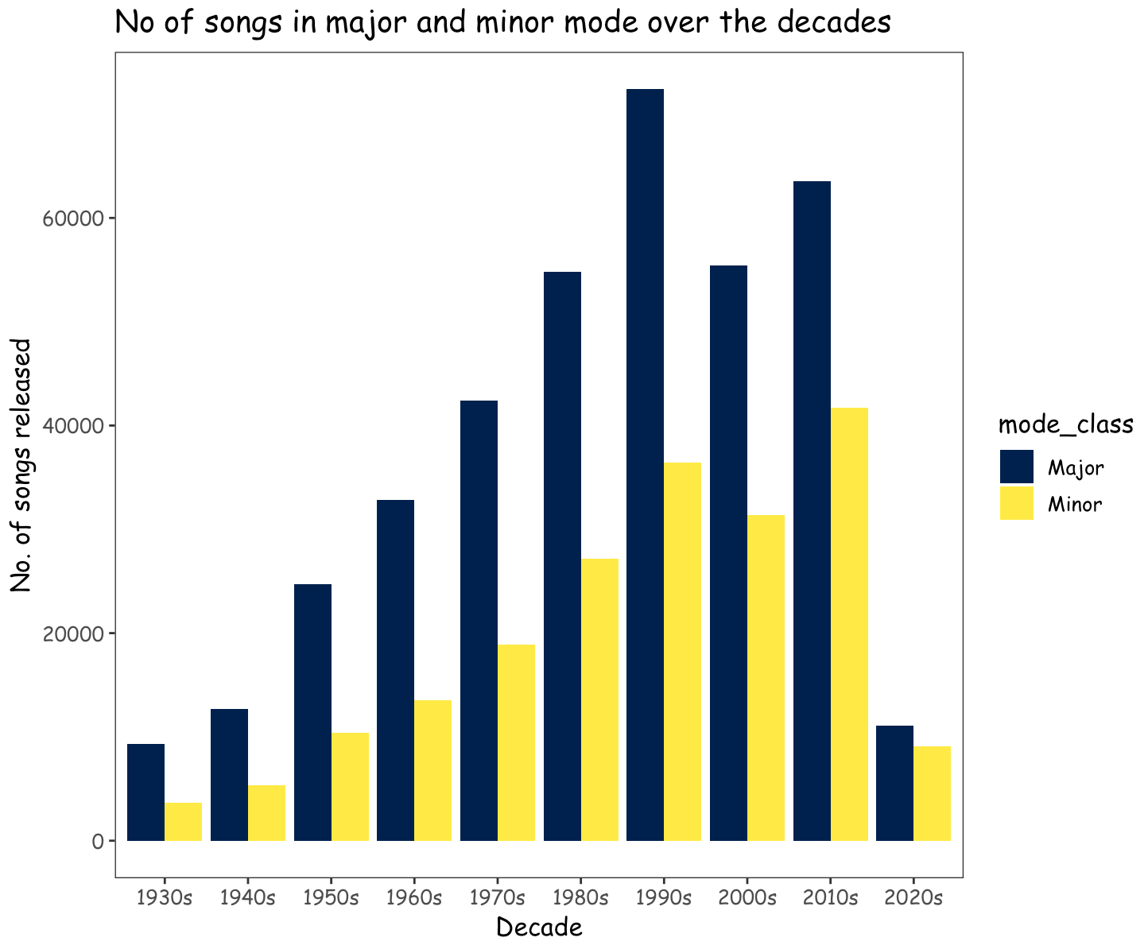
Popular choice for the mode of songs by the music composers over the decades - Major mode
Majority of the songs in the decades 1930s - 2020s have been composed in major mode.

Slide 11
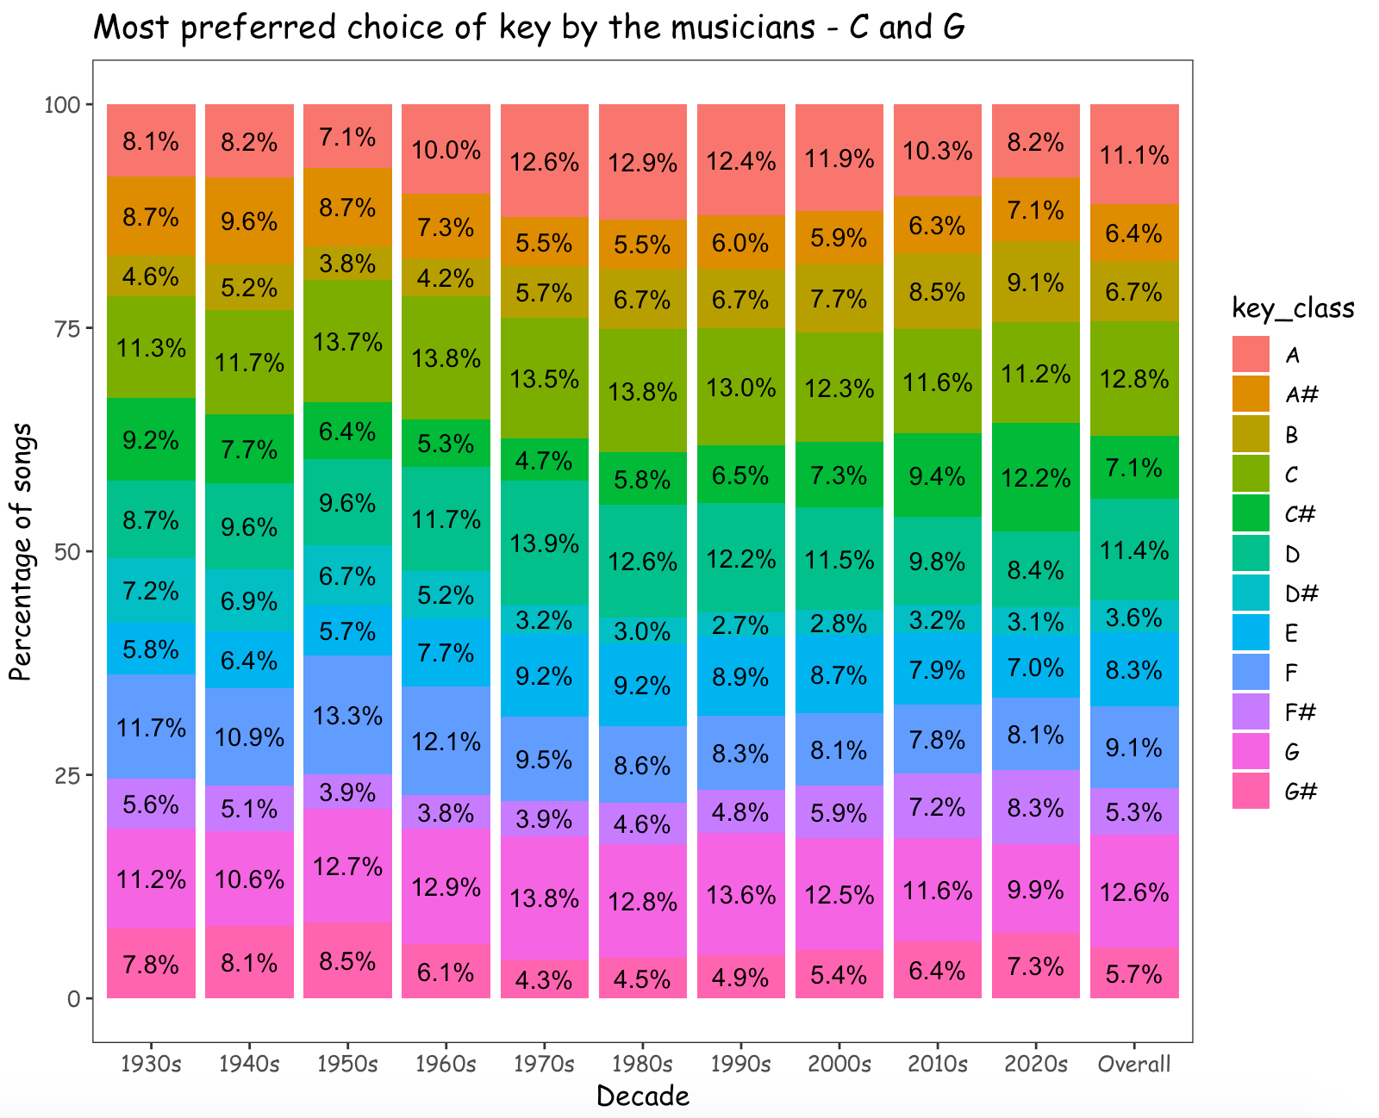
Percentage of songs in each key over the decades : 1930s - 2020s
We can observe that the keys C and G have been used to compose 25% of the songs and most preferred by the musicians.
Source : G Major and C Major rule all other keys

Slide 12
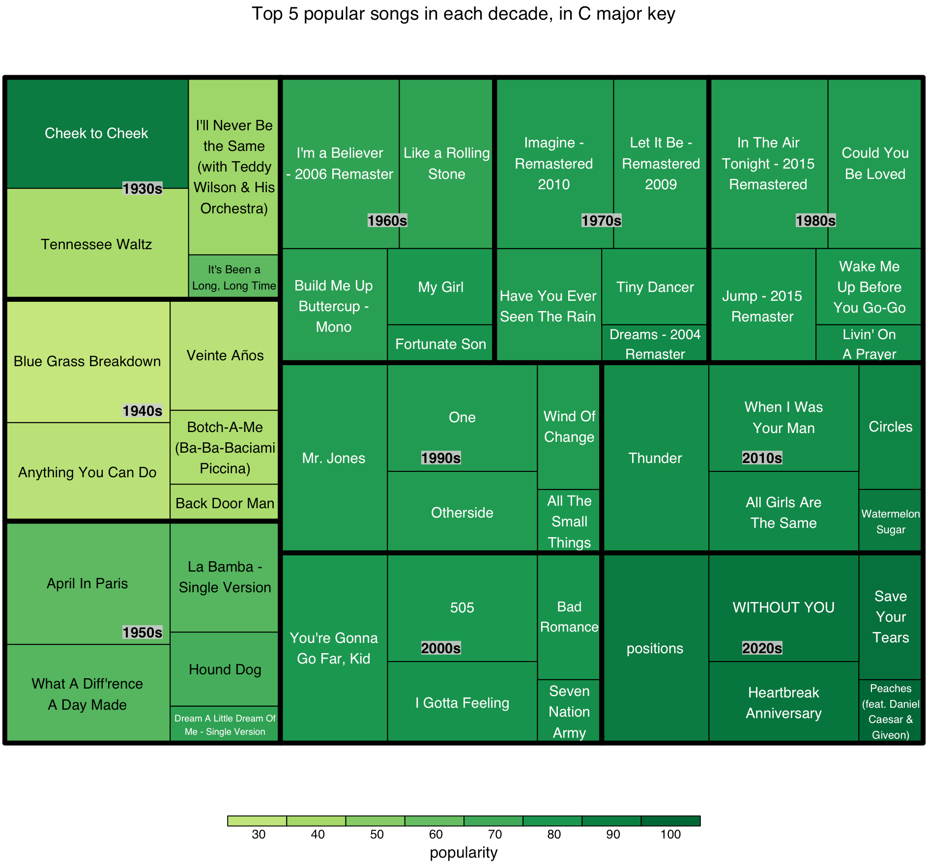
Top 5 popular songs in C major key in the decades 1930s - 2020s

Slide 13
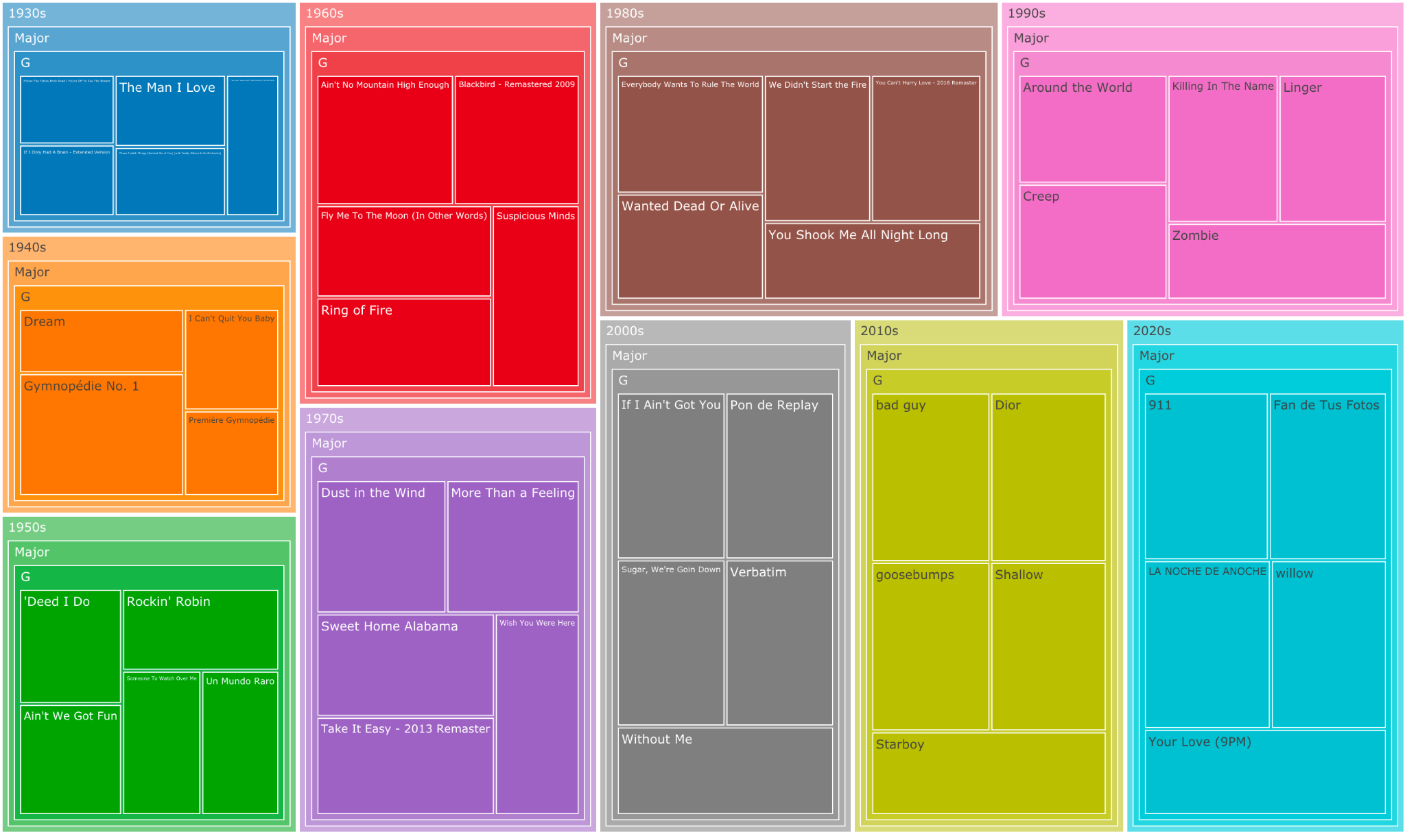
Top 5 popular songs in G major key in the decades 1930s - 2020s

Slide 14
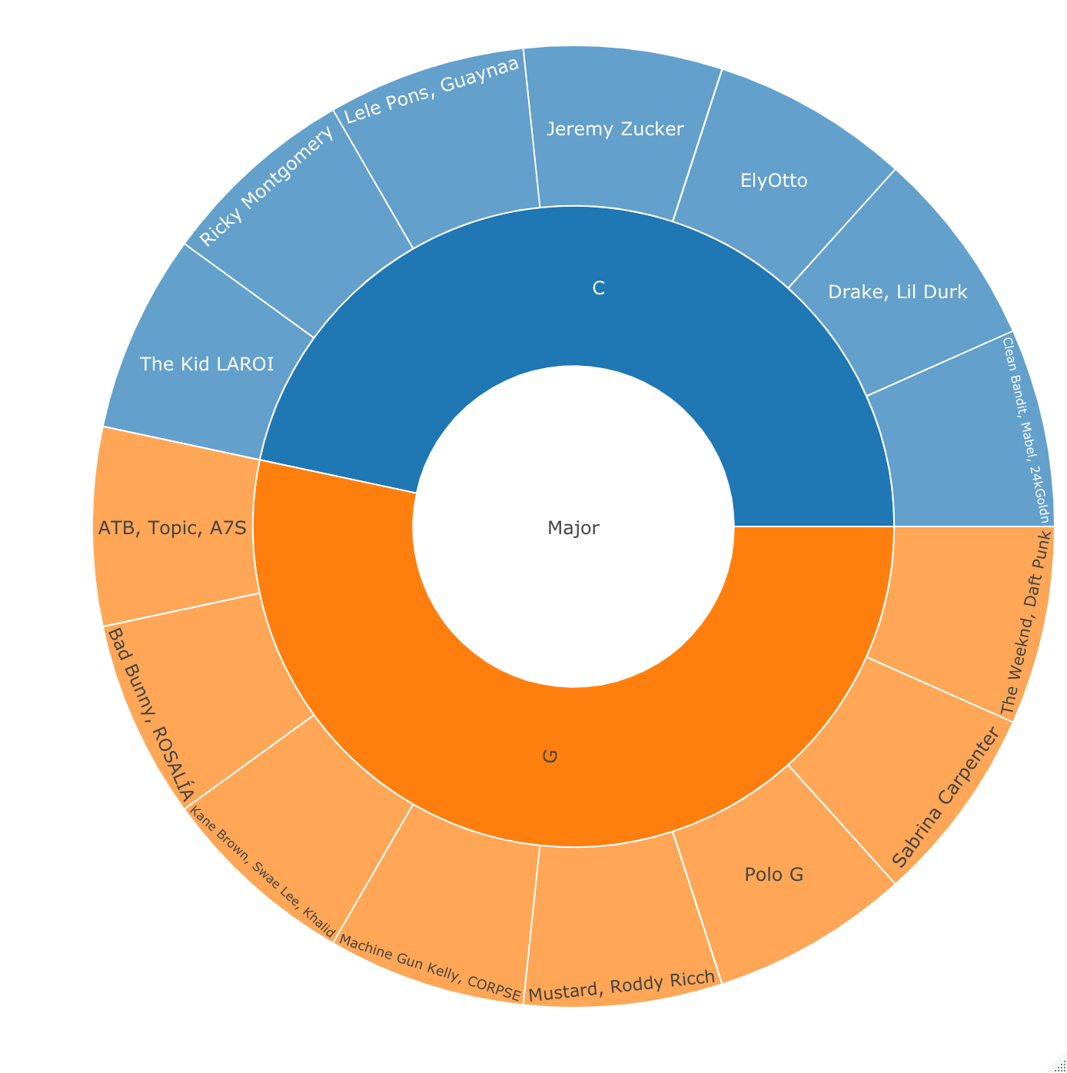
Top 15 popular artists of songs in C major and G major scale:

Slide 15
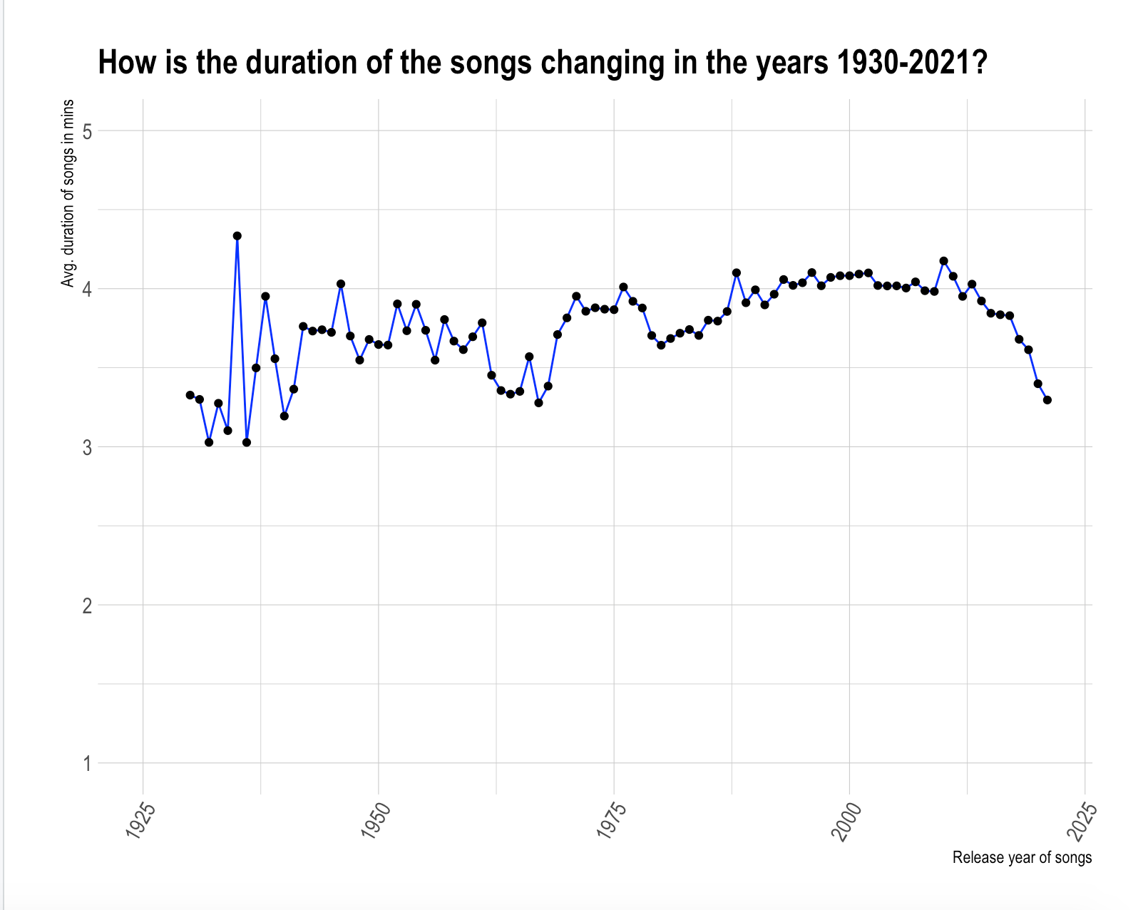
Average duration of the songs 1930-2021
A downward trend in duration of the songs is observed in the last 20 years.
We can expect the average duration of the songs to fall below 3.5 mins in the upcoming years,by following this trend.

Slide 16
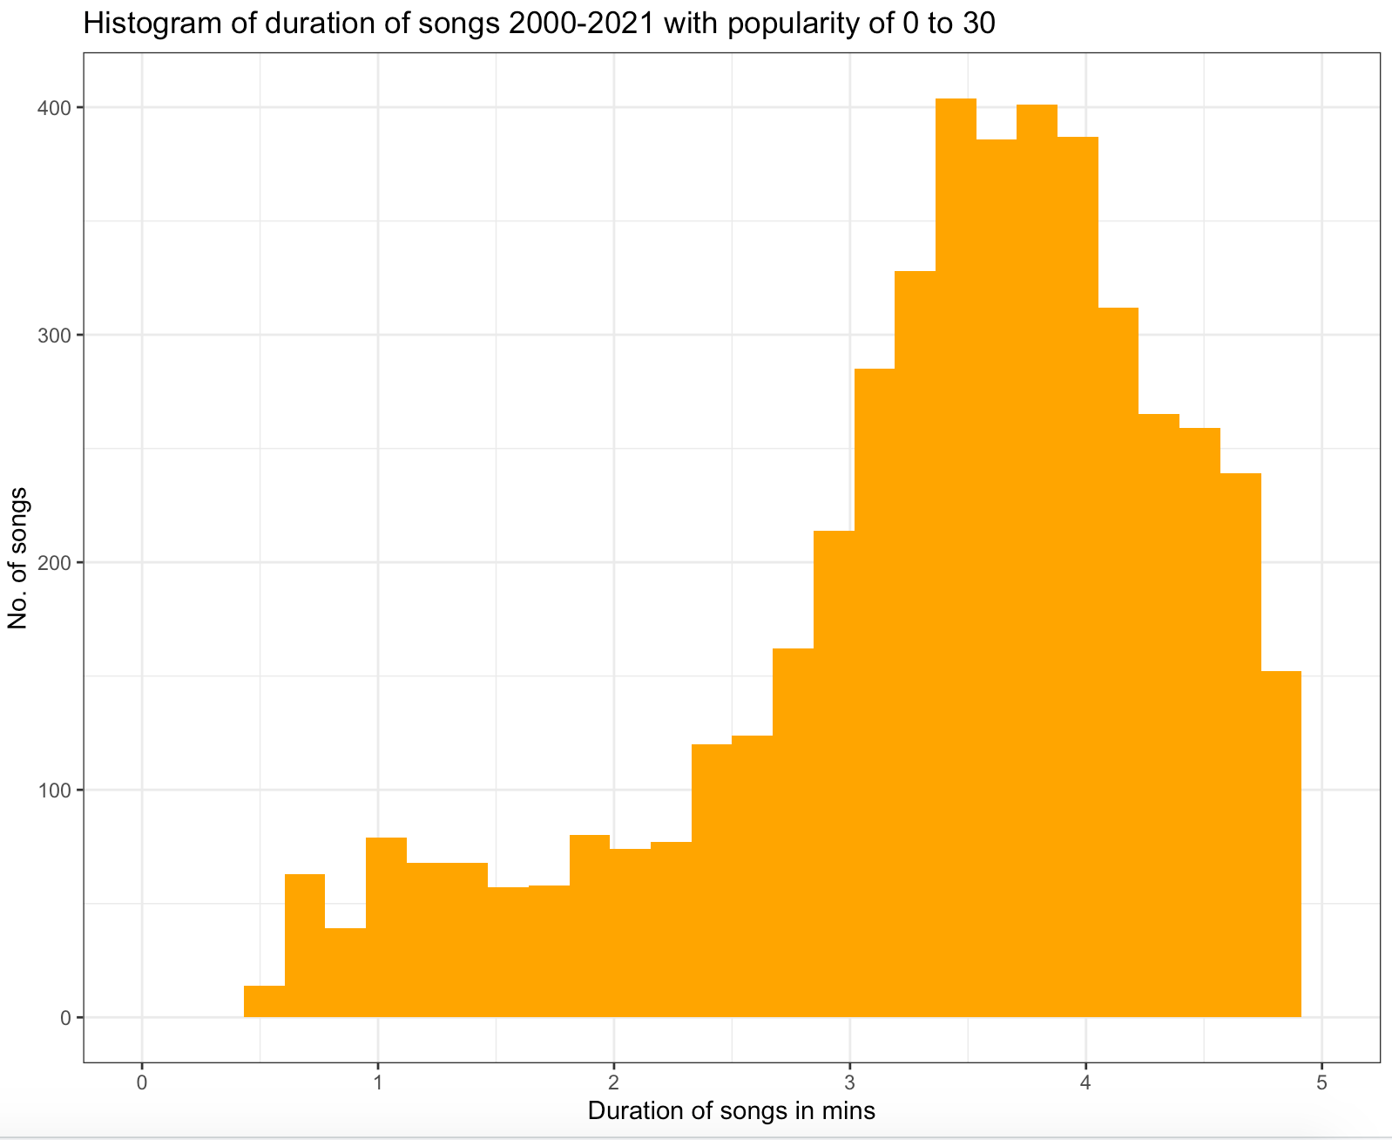
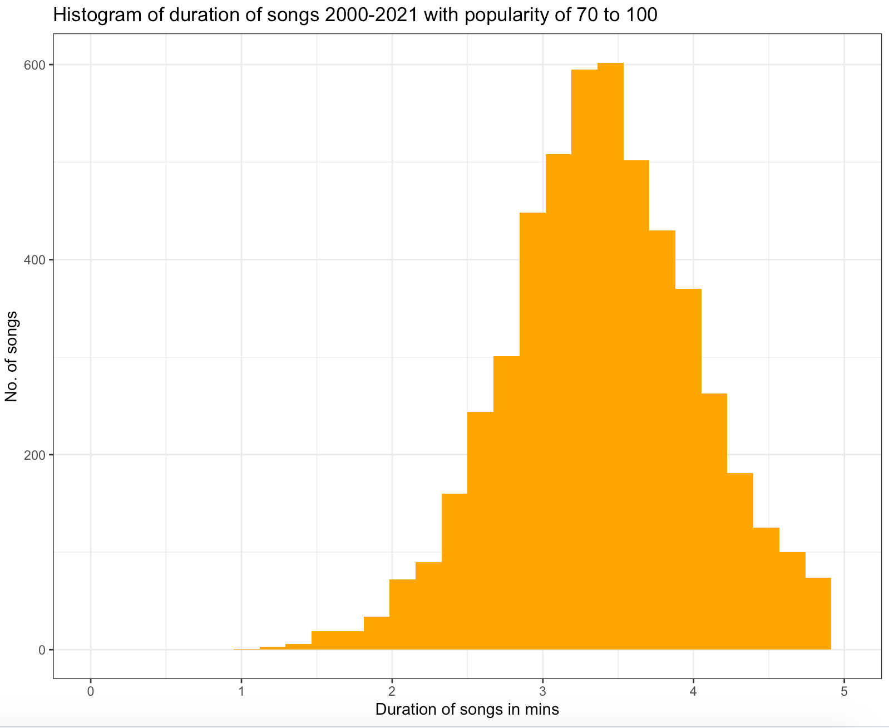
No of songs released in 2000-2021
with popularity 0-30: 5500
No of songs released in 2000-2021
with popularity 70-100: 5402

Slide 17
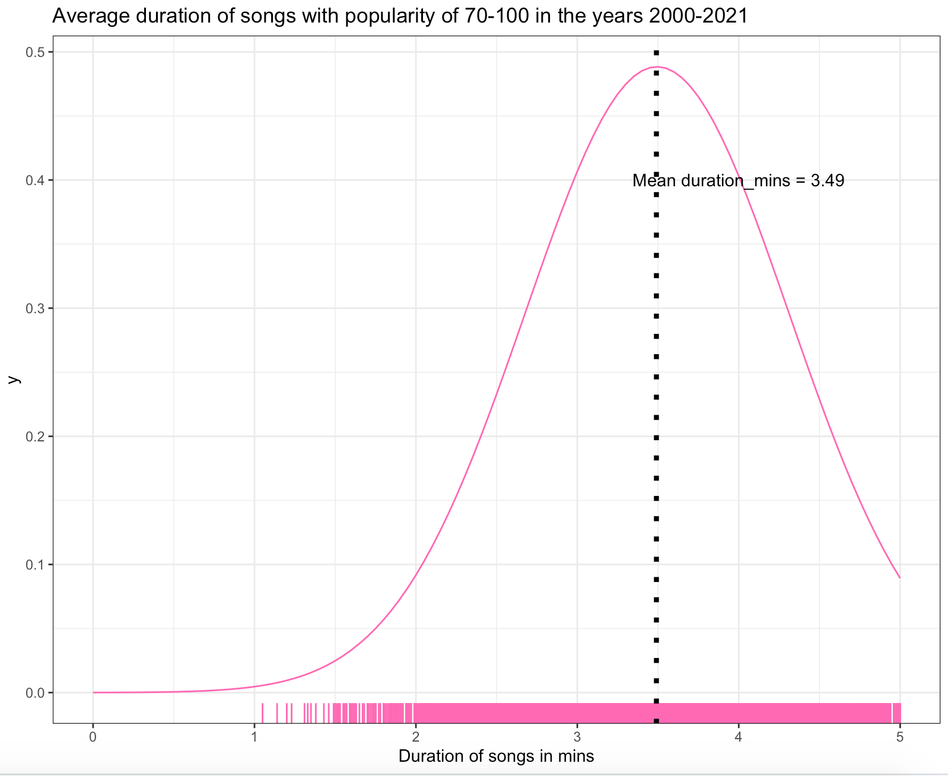
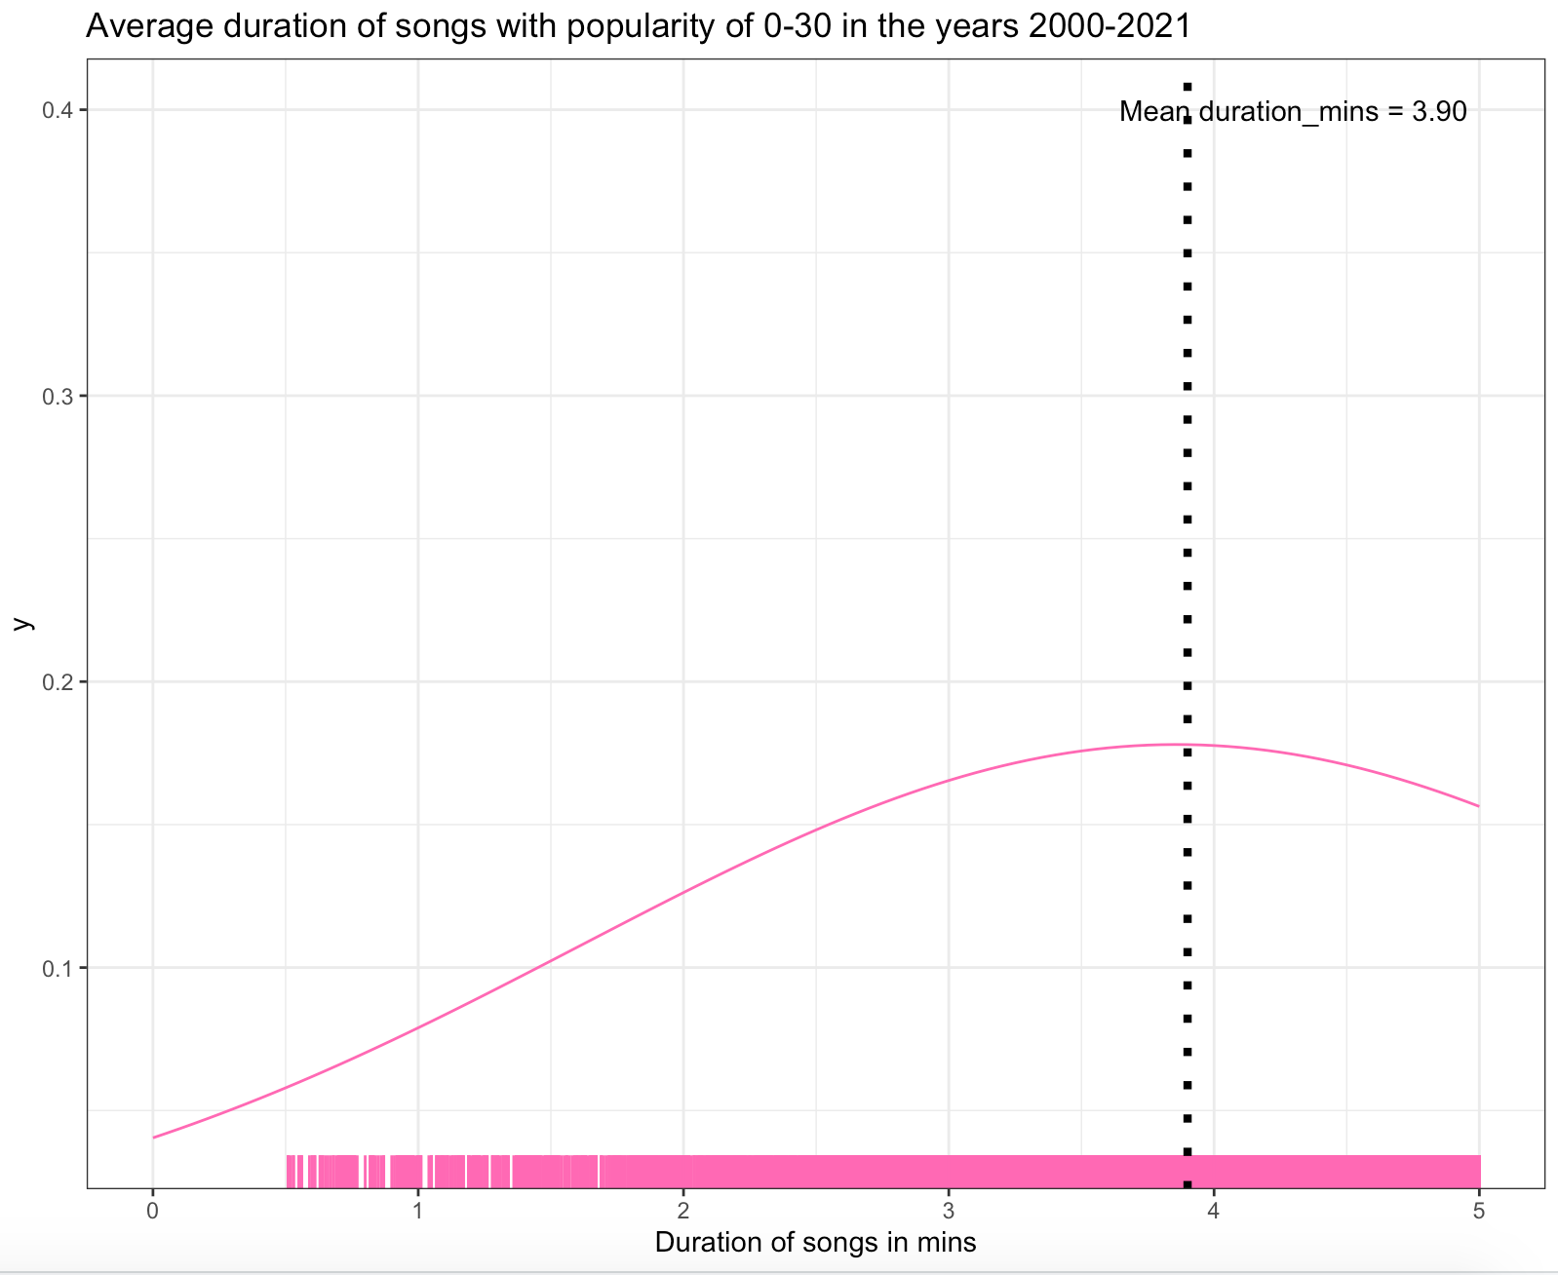
Most popular songs are shorter in duration than the least popular songs (2000-2021).

Slide 18
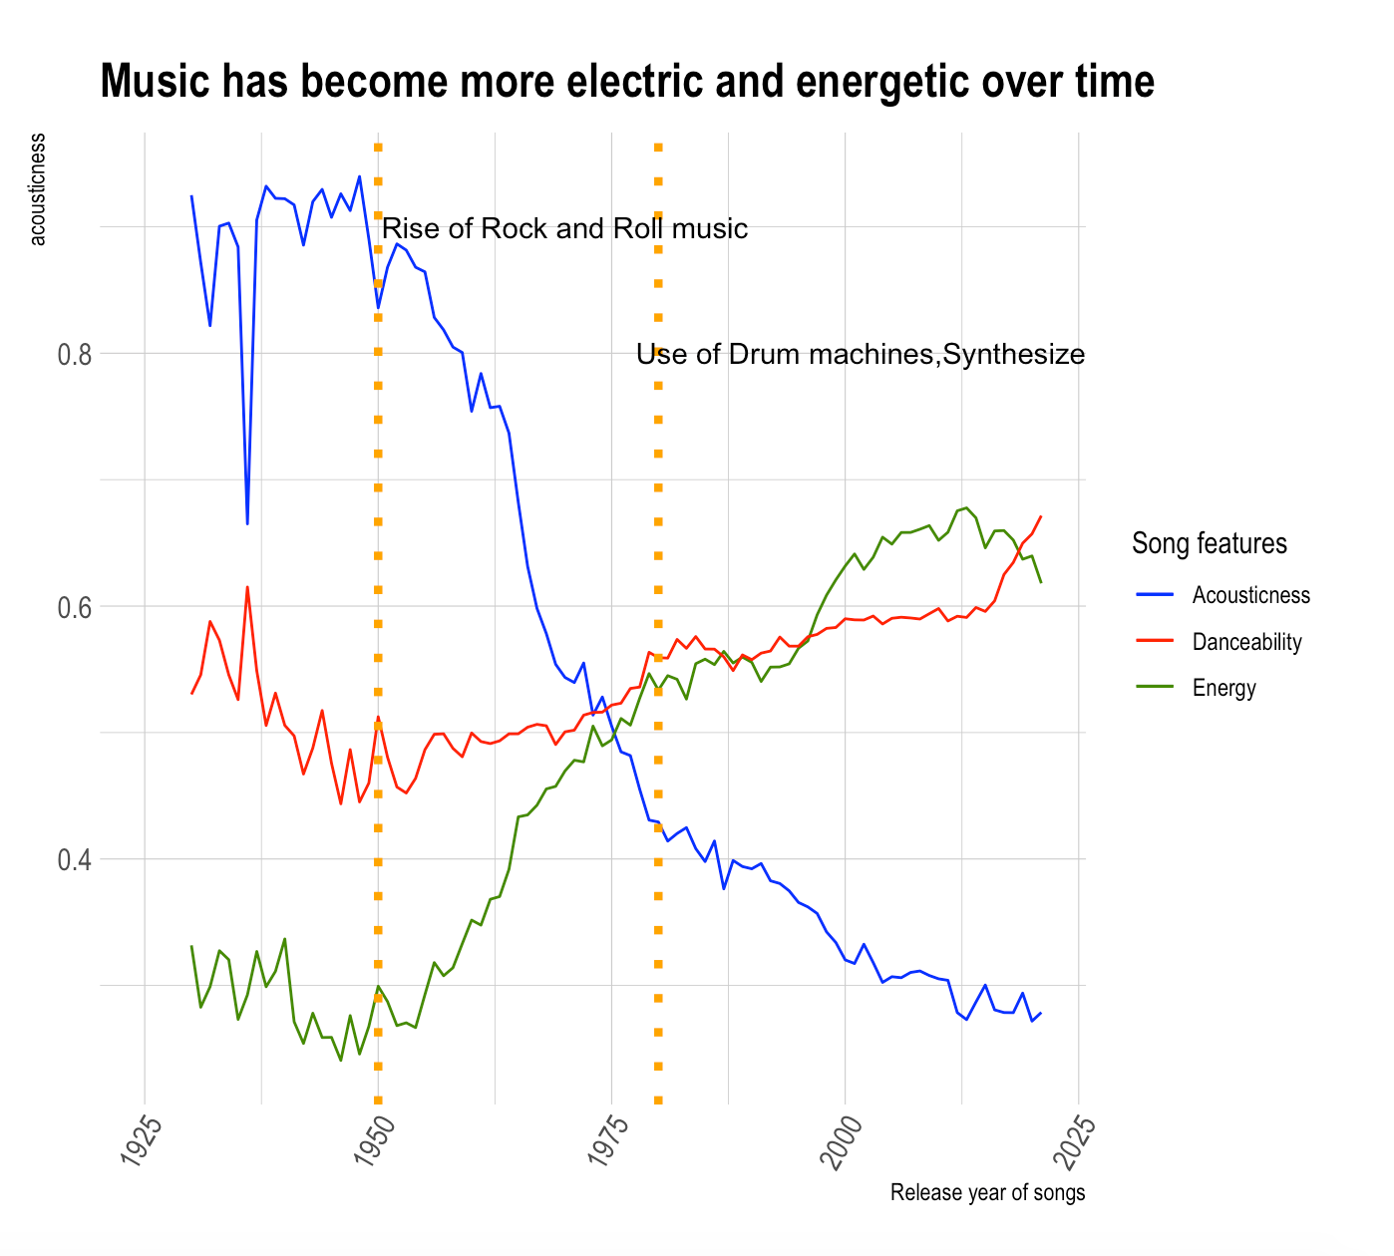
Trend of acousticness, danceability and Energy of the songs released in the years 1930-2021

Slide 19
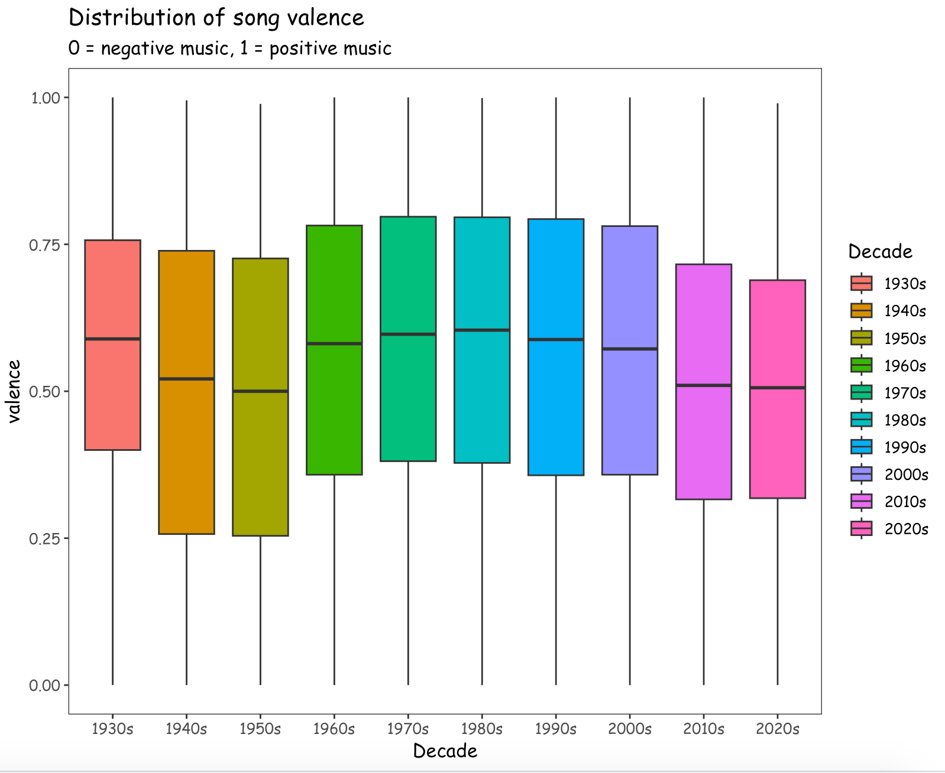
Box plot of songs valence over the decades:
Starting from 1980s, song positivity is decreasing every year.

Slide 20
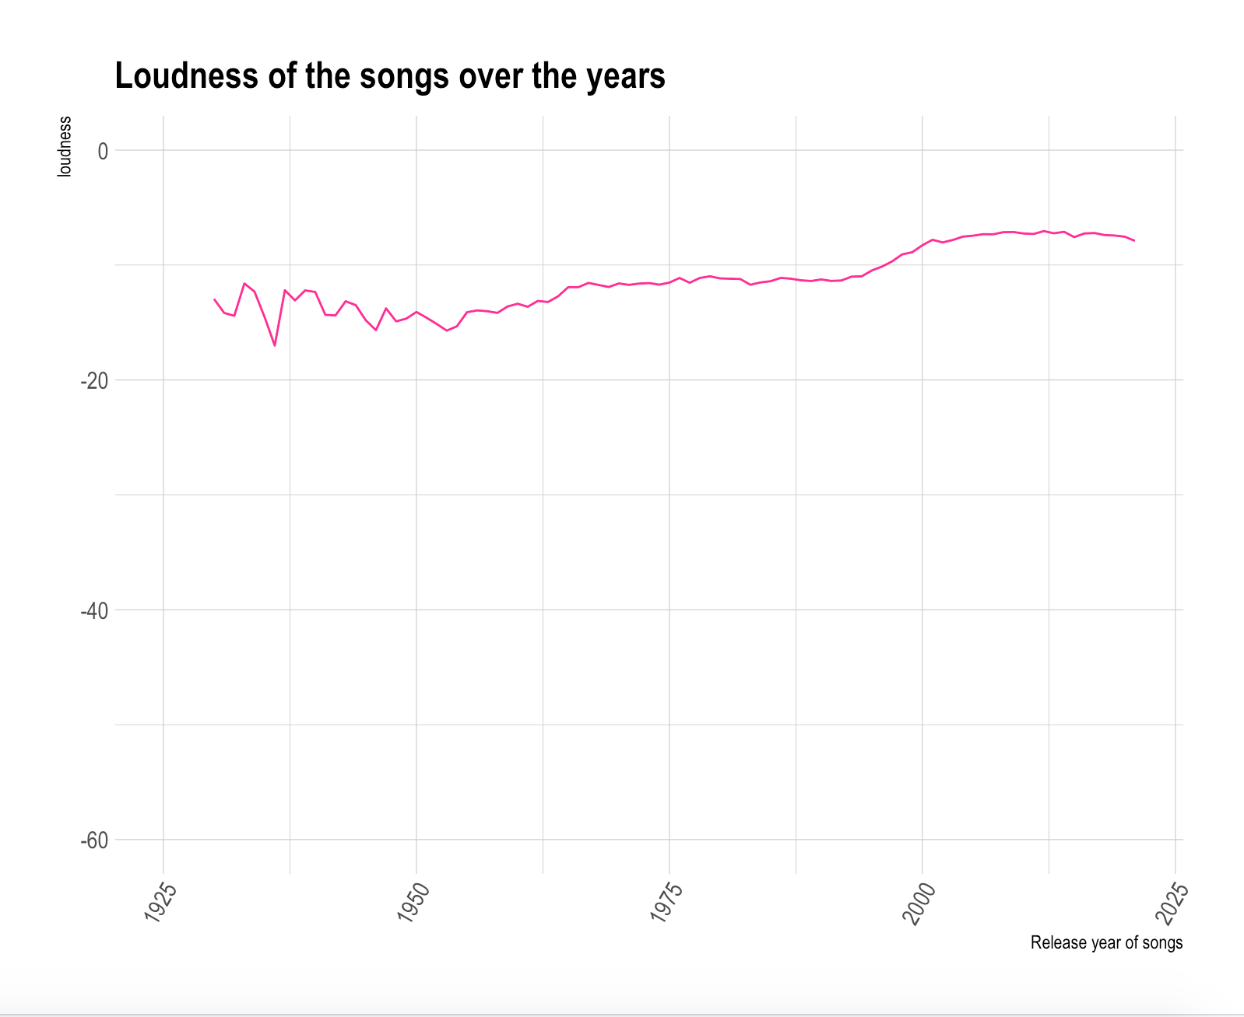
Loudness of the songs released in the years 1930-2021
The loudness of songs is increasing every year.

Slide 21
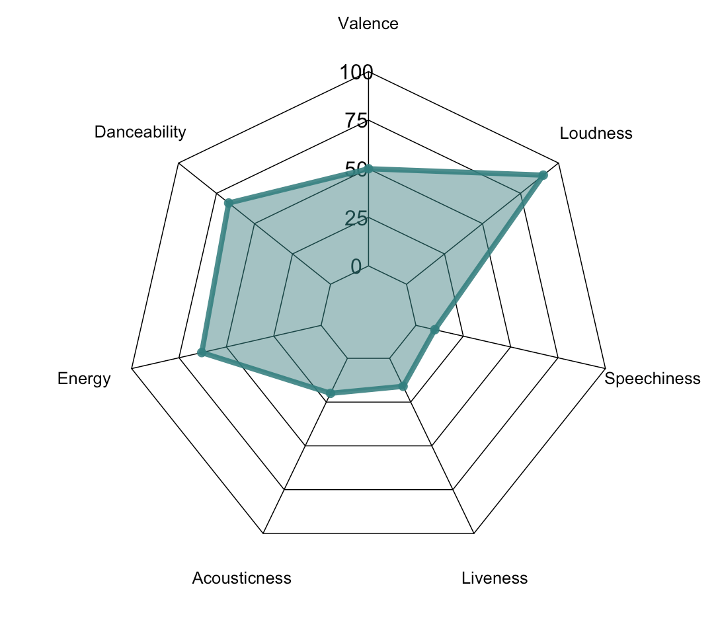
What is the common pattern in the audio features of the top 1000 most popular songs released in the years 2000-2021?
Top 1000 popular songs are having high loudness score, energy and danceability.
They are sounding less acoustic, and having a balance of vocal content and instruments.
Most of the popular songs are recorded in a studio and not captured with live audience.
Songs are having a neutral valence score , which means that they are not sounding very happy or very sad.

Slide 22
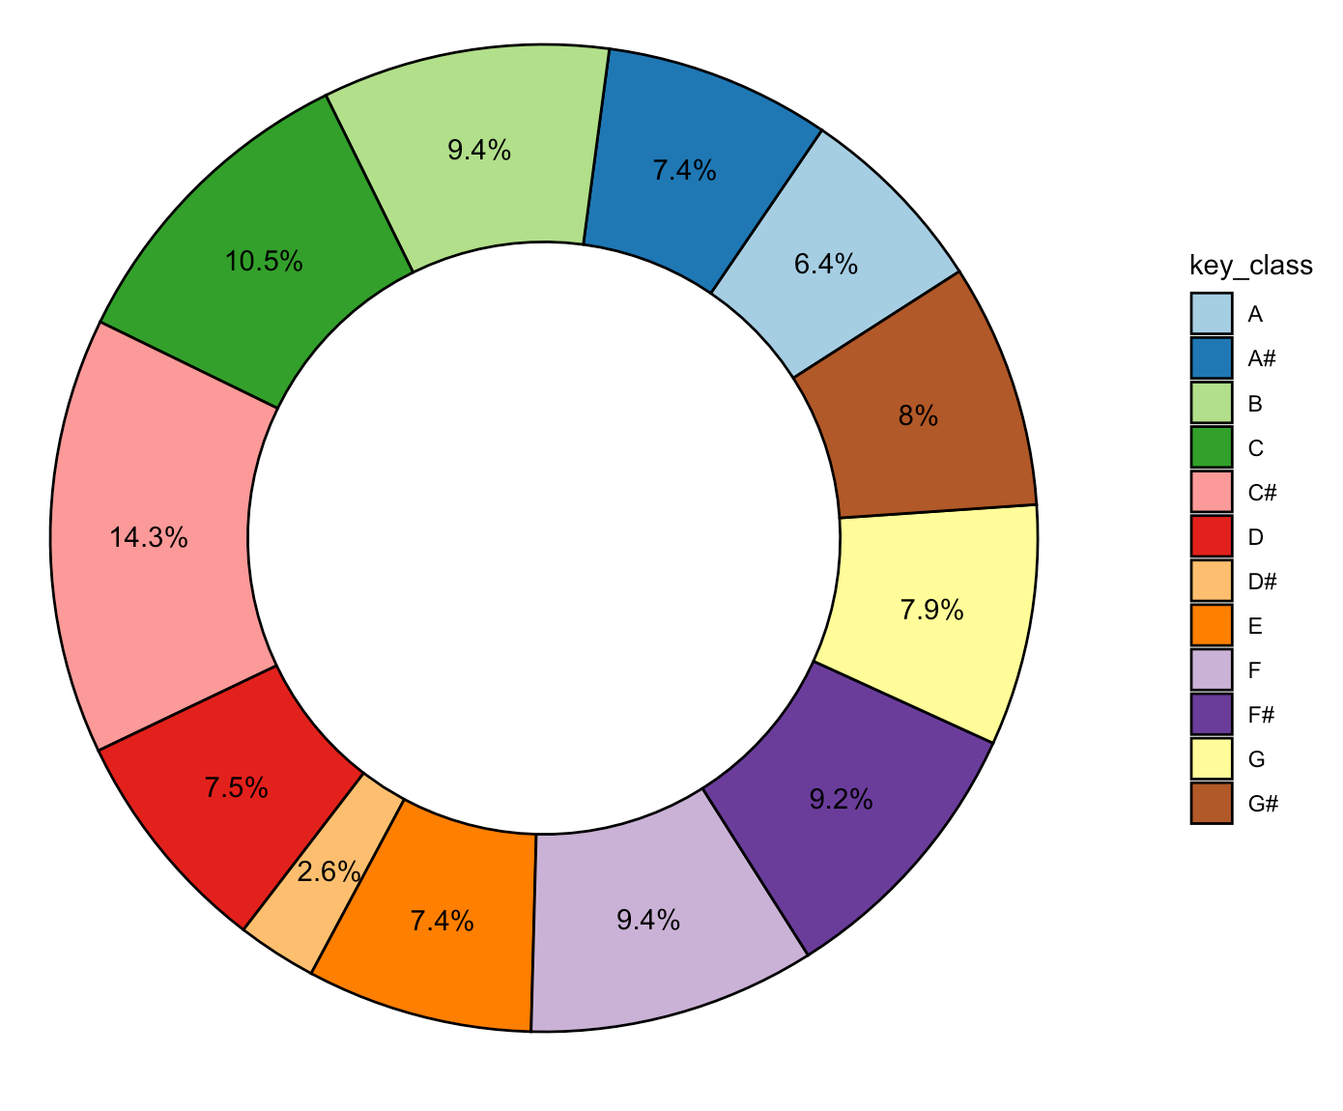
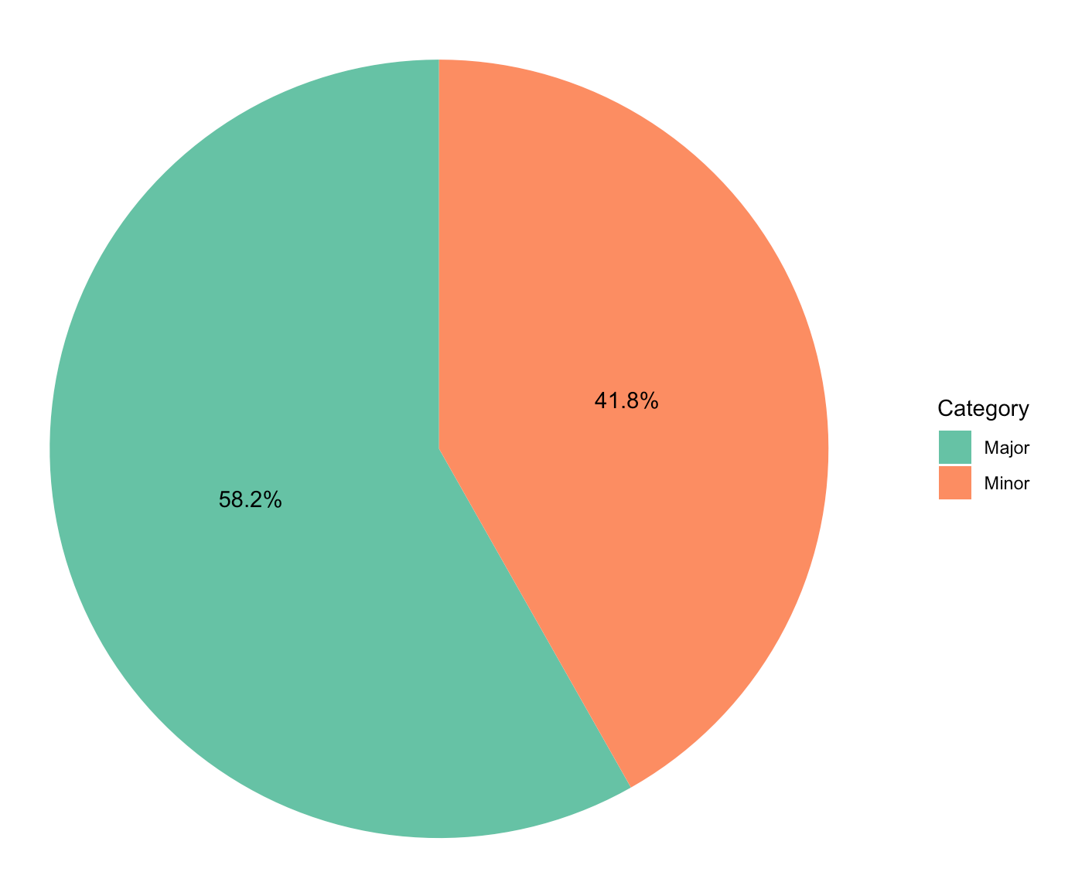
What is the percentage of keys and modes found in the top 1000 popular songs 2000-2021?
C# is the most used key. D# is the least used key.
Major mode is the most used than the minor mode.

Slide 23
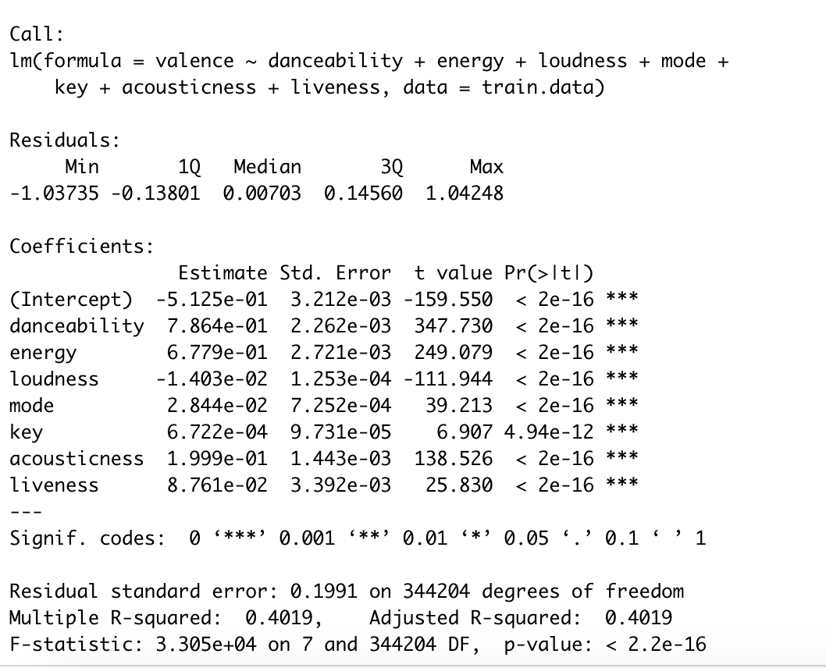
Linear regression : Model 1 : Prediction of valence attribute of a song
Initial steps:
Eliminated the outlier records.
Scaled the input attributes in the range of 0-1.
Divided the dataset into training and testing data.
80% of the data is used during training, 20% of the data is used in testing phase.
Independent variables: danceability, energy, loudness, mode, key,acousticness, livenes.
Dependent variable:
Valence

Slide 24
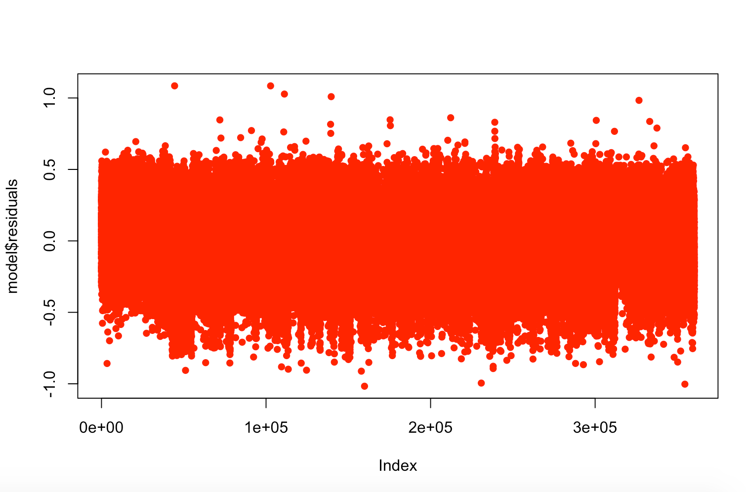
Linear regression : Model 1 : Prediction of valence attribute of a song

Slide 25
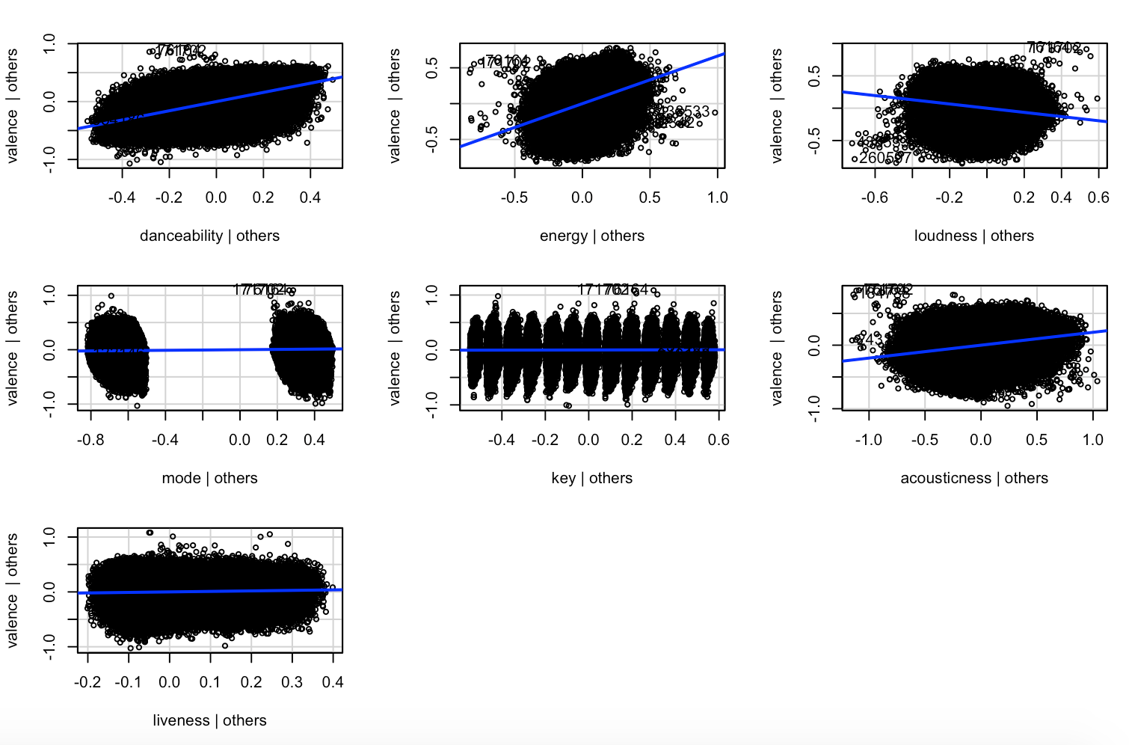
Linear regression : Model 1 : Prediction of valence attribute of a song

Slide 26
Linear regression : Model 1 : Prediction of valence attribute of a song
Interpretation of R-squared,residuals and p-value:
R-squared value is 0.40 which means that the model explains 40% of the variance in the dependent variable that the independent variables explain collectively.
The residual standard error is 0.1 which means that the data points are closely packed around the fitted regression line.
P-value is very small for all the independent variables. This means that these variables are a great addition to the model in predicting the target variable.

Slide 27
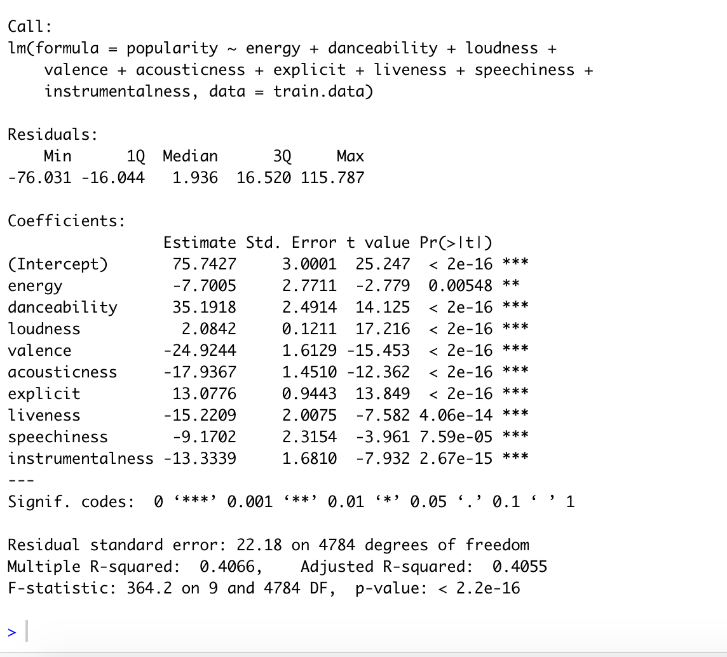
Linear regression : Model 2 : Prediction of popularity attribute of a song
Initial steps:
Eliminated the outlier records.
Scaled the input attributes in the range of 0-1.
Divided the data into two classes: all the songs with popularity >= 75,
Equal number of song samples with popularity < 75 (undersampling).
Divided the dataset into training and testing data.
80% of the data is used for training the model, 20% of the data is used in testing phase.
Independent variables: danceability, energy, loudness, mode, key,acousticness, livenes,valence,explicit,speechiness,instrumentalness
Dependent variable:
Popularity

Slide 28
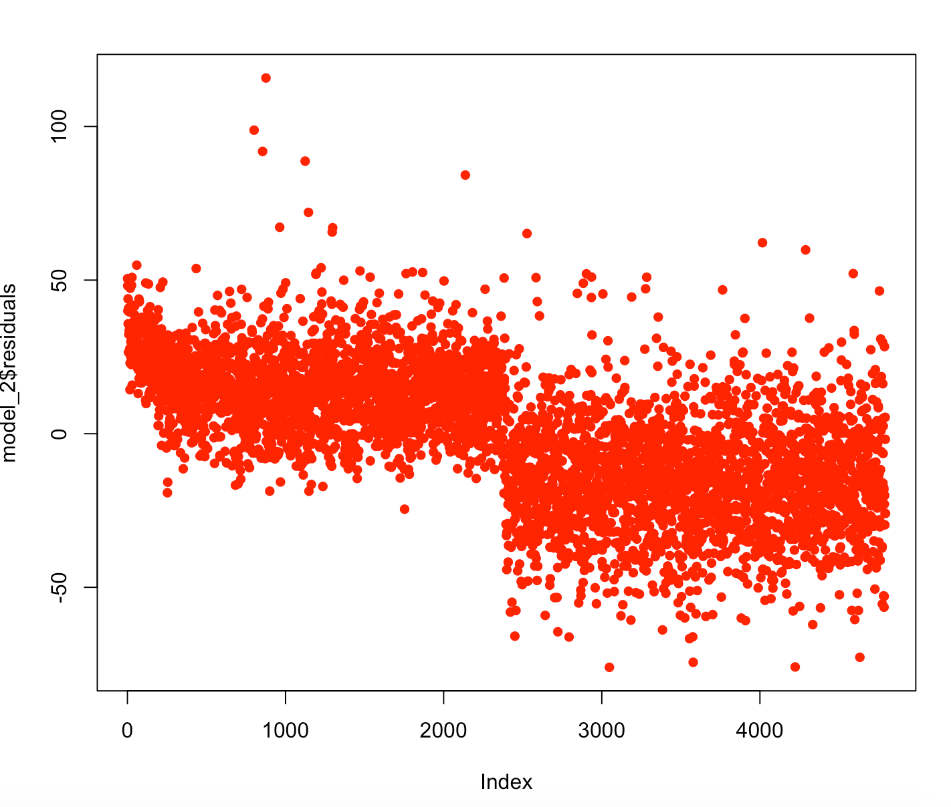
Linear regression : Model 2 : Prediction of popularity attribute of a song

Slide 29
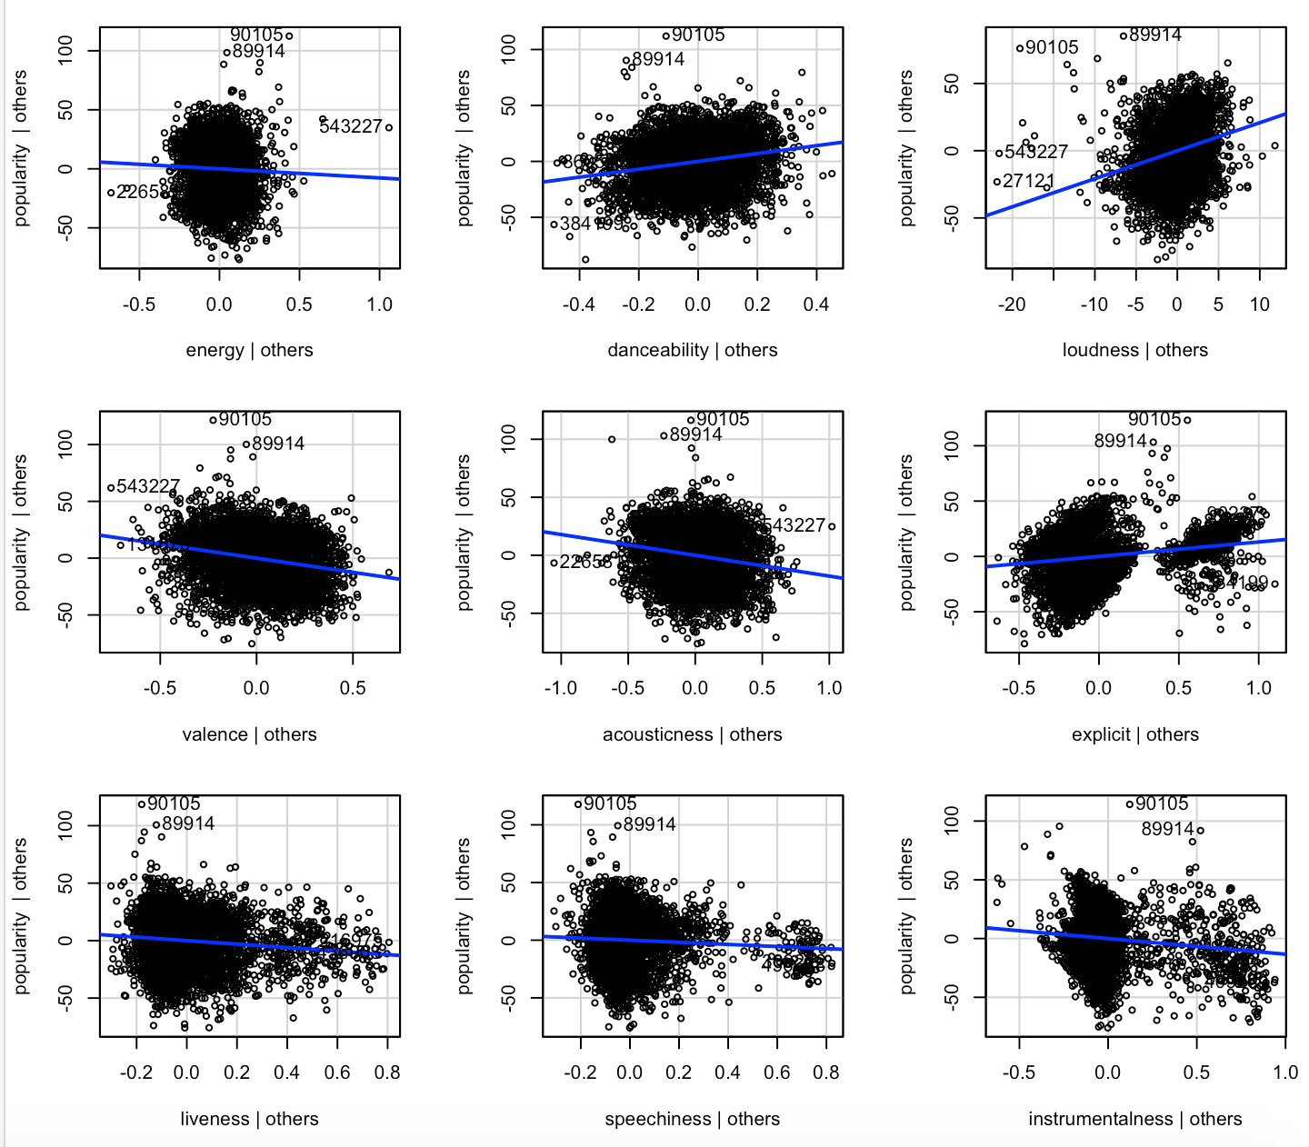
Linear regression : Model 2 : Prediction of popularity attribute of a song

Slide 30
Linear regression : Model 2 : Prediction of popularity attribute of a song
Interpretation of R-squared,residuals and p-value:
R-squared value is 0.40 which means that the model explains 40% of the variance in the dependent variable that the independent variables explain collectively.
The residual standard error is 22.18 which means that the data points do not fall closely with the regression line and the difference between the predicted and actual output value is high.
P-value is very small for all the independent variables except for the energy attribute. This means that these variables are a good addition to the model in predicting the target variable .

Slide 31
References:
https://www.kaggle.com/. (2019). Retrieved from.
https://www.kaggle.com/code/vhtrieu/spotify-track-popularity-analysis-and-prediction/data?select=tracks.csv

